Slide 1

EPA Fraud in water system Science and Analysis

Slide 2
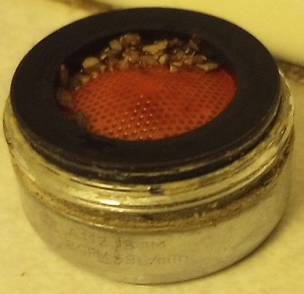


EPA Fraud
In Water System Science and Analysis
Metallic and Ionic Lead
in our water supply, in the
United States of America
John Patrick Brandon
Citizen Scientist
04/20/2025
460 Almeron St.
Evansville WI 53536
trinity7@tds.net

Slide 3
EPA Fraud in water system Science and Analysis Metallic and Ionic Lead in our water supply, in the
United States of America
Format – To find commentary and source links, Click on “Notes” icon below, or just drag up the border, right above the bottom task bar.
Since this Study is going out to some of my neighbors, I make analogies to things that we commonly deal with in life as examples. Comments addressed to my neighbors will be bolded, or in red (for emphasis).
Most sources are credited. I am pressed for time. This study must be available now to help people who will shortly be forced to pay for water laterals that they don’t need.
Biographical information will be near the end of the PowerPoint. This is not about me, it’s about my neighbors, who are very special people. I am greatly indebted to them.
Table of Contents
Purpose of this work P. 5
One sentence summary P. 6
                P. 7-8
Timeline P. 9
Wisconsin Lead Circle/Summary (Important) P.10
Lead in the Soil and Environment P. 11-14
Cost effective solution to TOTAL lead in the home P. 15-16
Table of Contents
Key points in Study P. 17
Media Brief P. 18
Cowardly Moronic Letter P. 19
Lead and Calcium Educational P. 20-24
Metallic and Ionic Lead
Notes:
Hi, look down here for notes on slides. Don’t forget to scroll all of the way down. Thank you so much. We need your help.

Slide 4
EPA Fraud in water system Science and Analysis Metallic and Ionic Lead in our water supply, in the
United States of America
Table of Contents, Continued
Table of Contents
Lead and Copper Rule
Compliance Sampling P. 28-48
Most important slides (Data) P. 34, 35, 36
Aerator/Sampling P. 42
Summary slides P. 37, 43,44,45
Importance of pipe deposits to Lead
And Copper Rule Compliance P. 50-58
Most Important slides P. 50, 56, 57, 58 EPA people in article P. 51-54
Scientific Summary P. 59-60
Table of Contents
City of Evansville, Wisconsin P. 62-68
Public Services Commission
(Madison Wisconsin) P. 69-71
John Brandon Biographical Information P. 72-78
Family Testimonial P. 79-81
To our Government branches P. 82
City of Evansville, WI government P. 83-90
Last Slide P. 91
Notes:
Hi, look down here for notes on slides. Don’t forget to scroll all of the way down. Thank you so much. We need your help.

Slide 5
EPA Fraud in water system Science and Analysis Metallic and Ionic Lead in our water supply, in the
United States of America
Purpose of this work
Expose the critical lack of practical elementary science in our Federal, State, and City Government’s action to force Citizens to replace plumbing at a remarkably high price.
Proclaim to our Government that extra taxes, mandated by a few, and exacted on a few, are contrary to our purpose as a nation.
Lock hands with the Citizens of the United States with common sense guides and thought. Our country is smart enough to make the right decisions for them, and their own families.
Highlight effective and inexpensive ways to combat Lead in the Home first, the environment second, and the drinking water, third.
Inform our friends and neighbors that the science is practical, and easy to understand.
Express gratitude toward the many, many people in our Federal, State, and local governments that do a great job. We appreciate those who succeed through intellect and effort.
Notes:
Hi, look down here for notes on slides. Don’t forget to scroll all of the way down. Thank you so much. We need your help.

Slide 6
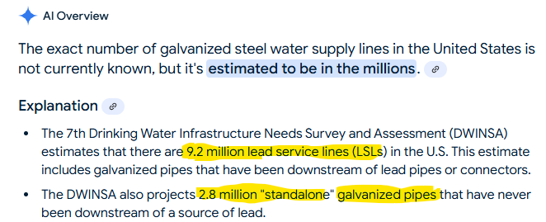
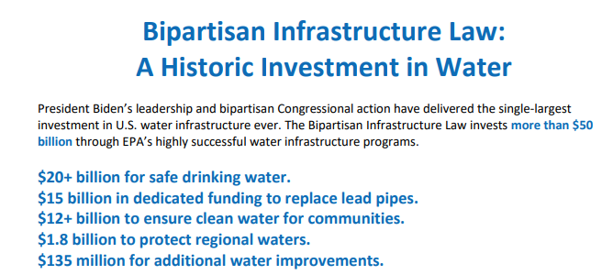



EPA Fraud in water system Science and Analysis Metallic and Ionic Lead in our water supply, in the
United States of America
One Sentence Summary:
I can save us (The United States)
30 billion dollars, today.
Notes:
The amounts vary, and will be in different buckets, depending on what source you read. (PLEASE scroll down all the way on these notes)
This is a huge amount of money the government wants to spend replacing Lead Service Laterals (LSL’s)
USA
9,200,000 LSLs (AI search above) x average of $4,700 (AI search) = $43,240,000,000 (forty three billion, two hundred forty million dollars). The 9,200,000 number seems to include Galvanized Steel lines that are downstream of any lead lines.
2,800,000 Galvanized steel lines (AI search above) x average of $4,700 = $13,160,000,000 (thirteen billion, one hundred and sixty million dollars)
Total, 56,400,000,000 Fifty six billion, four hundred million dollars
Subsequent slides will concentrate on chronology of events, poor Science, and incorrect interpretation of data.
In Madison Wisconsin, We had 9,000 lead lines, depending on source information. My quote was low, $3,500 (to replace a galvanized steel line, Evansville, WI). Many pay in the mid $5,000’s to excavate/replace plumbing.
9,000 x $3,500 = $31,500,000 (thirty one million dollars). Many/Most sources say the work in Madison was complete in 2011.
Madison offered it’s people up to ½ of $3,000 ($1,500 max), in subsidy for private installation, which means that the minimum that people had to shell out of their pockets, in addition to paying additional taxes, would be $2,000. Most people would pay considerably more.
IN MY NEIGHBORHOOD, THESE WERE EXTRA TAXES FOR WATER SUPPLIES ON TOP OF EXTRA TAXES FOR SIDEWALKS, ON TOP OF ALL OTHER TAXES
The Wisconsin Department of Natural Resources (WNDR) changed the formula for awarding grants in 2024, thus the people of my street received NOTHING in subsidy

Slide 7
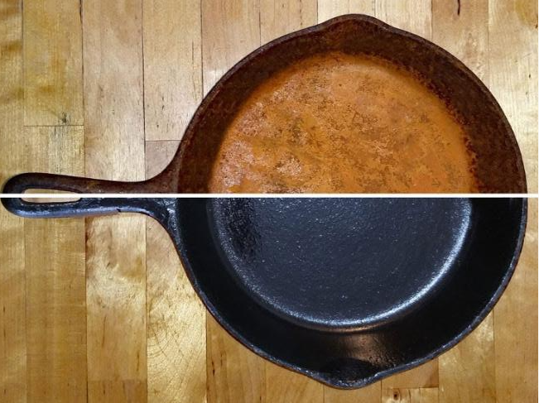
EPA Fraud in water system Science and Analysis Metallic and Ionic Lead in our water supply, in the
United States of America Shell game: Metallic and Ionic Lead
Critical in all of the Science, is that the 2 main forms of metal are vastly different. This example uses Iron, but the same principle applies to lead.
Ionic/oxidized/Soluble is dangerous (For Lead, not Iron) because it is EASILY DIGESTED (adsorbed into the body)
Particulate/metal/insoluble is much, much, less dangerous, in that it is difficult to digest.
Ionic
Metallic
EPA/WDNR/Scientific community all agree that virtually all of lead in the water system end use IS PARTICULTE/Insoluble, and thus can be easily filtered out. Water systems use anti corrosives (phosphates) to reduce oxidation of metal. (lead and iron). So, the fact of the matter is, we don’t need to replace plumbing, and can use a much more effective solution to Lead mitigation (filtering).

Slide 8

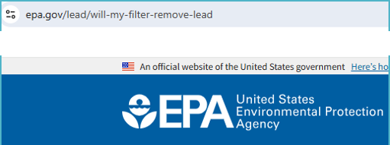
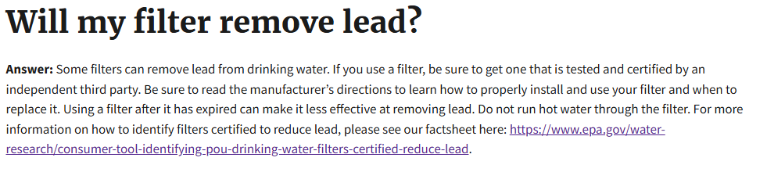




EPA Fraud in water system Science and Analysis Metallic and Ionic Lead in our water supply, in the
United States of America Metallic vs Ionic EPA AGREES FILTRATION WORKS
Metallic
vs
Ionic
Metallic, Elemental, Solid, Scale, INSOLUBLE
vs
Ionic, Salt, Oxidized, Dissolved, SOLUBLE
Water analysis scientists are nearly universally agreed that lead in drinking water is predominantly Metallic/Elemental/Solid/Insoluble, and thus, can be easily, and effectively FILTERED.
Notes:
1) For over 30 years the Feder Environmental Protection agency (EPA) and Wisconsin Department of Natural Resources (WNDR) have been crying LEAD. Their strategy for Lead reduction is fundamentally flawed. They have pushed plumbing replacement and infrastructure replacement, at a huge cost, when there are inexpensive and effective solutions available.

Slide 9
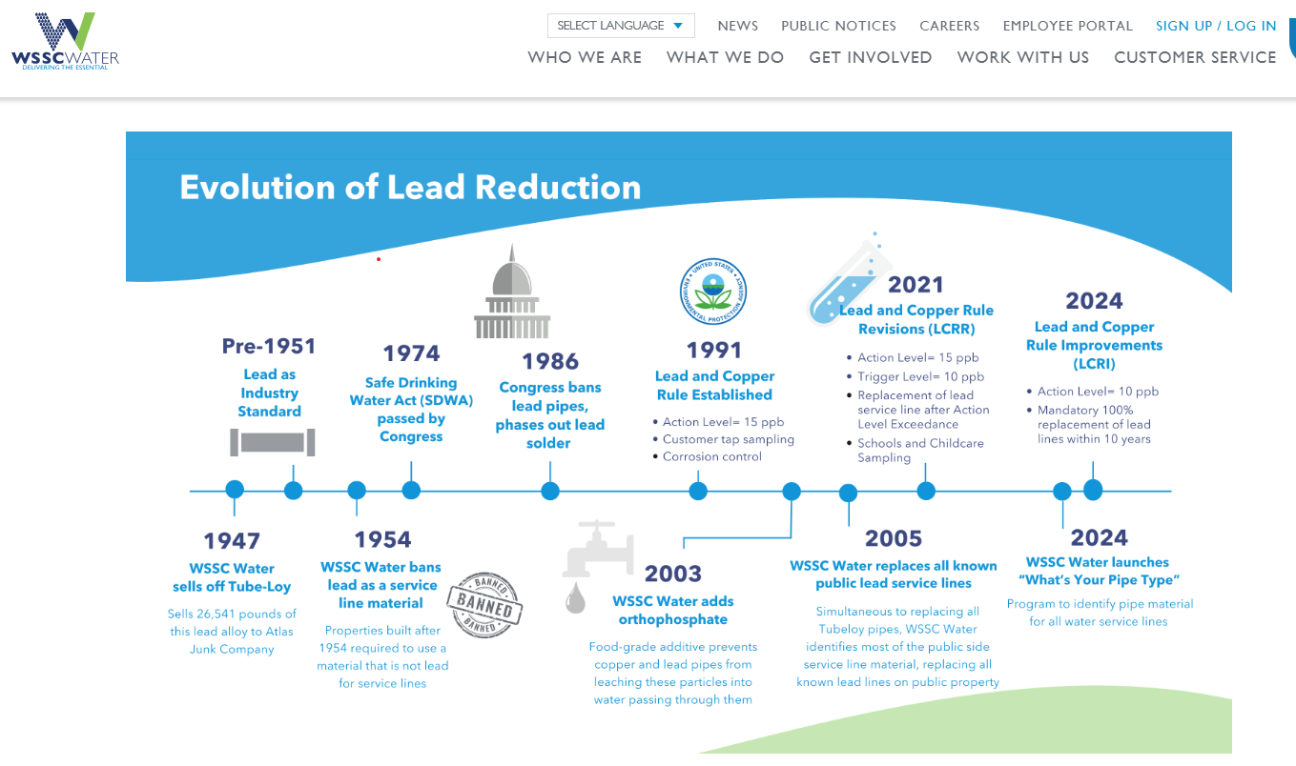













EPA Fraud in water system Science and Analysis Metallic and Ionic Lead in our water supply, in the
United States of America
1992: Madison WI, 16ppb warning level, EPA
2014
Flint Michigan water crisis
Notes:
Pasted timeline, source upper left
Red arrows mine, with box descriptions
Note that the Bipartisan Infrastructure Law mandates that WATER SYSTEMS replace lead laterals, not the END USER

Slide 10
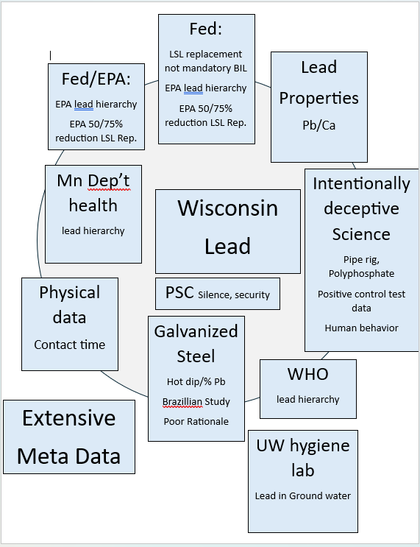
EPA Fraud in water system Science and Analysis Metallic and Ionic Lead in our water supply, in the
United States of America
Data/Corroboration from MANY different sources
Please read the notes in this slide in their entirety.
This is the most succinct summary in the whole presentation and scientific outlay.
The EPA was brilliant in their strategy:
Raise a FALSE CRY about Lead in the drinking water
Pick the most expensive and least effective mitigation for Lead contamination.
Use the Flint Water Crisis as a springboard to regulatory action, rather than accepting responsibility.
Force the states do the work and bear the expense
Notes:
In this diagram are talking points for lead in drinking water. It illustrates nicely that corroborating evidence for the IDIOCY of replacing Lead water lateral supplies (LSL, Lateral, etc.) as mandated by the Wisconsin State Government/Department of Natural Resources (WNDR), and the Federal Environmental Protection Agency (EPA).
Lead hierarchy – Exposure to lead based paint in homes and lead in the soil are by far the most likely avenue for exposure in the USA. Additionally, lead in the soil/paint is predominantly ionic/oxidized (bad form). The World Health Organization (WHO), The Minnesota dep’t of health, and EPA all agree that drinking water is a low level exposure hazard compared to soil and lead based paint
Sources: World, Federal, State
https://www.health.state.mn.us/communities/environment/lead/fs/common.html
https://www.who.int/news-room/fact-sheets/detail/lead-poisoning-and-health
EPA in slides later
LSL replacement not mandatory in the BIL – The Bipartisan Infrastructure law CLEARLY says WATER SYSTEMS must replace the laterals, not the end user/customer. As well, this is a 10 year plan.
EPA 50/75% reduction of Lead upon LSL replacement (Lateral replacement NOT effective in Lead elimination) – The EPA and other agencies often mention this, but don’t post data for it. Strange. We’ll go over some data in the scientific writing, for the ever-popular nerd-fest.
Lead properties Pb/Ca. Pb is the atomic symbol for Lead (think Plumbing). Ca is Calcium (well, at least that one makes sense). There’s a couple of slides on this later. Lead and Calcium are similar, thus the medical/developmental issue.
Intentionally deceptive science – lots of slides on this. We were lied to regarding the danger of lead in drinking water in several respects.
UW hygiene lab – I’ve talked with the University of Wisconsin state Hygiene lab many times. These people are heros. They do good work, and they tell the truth. They are scorchingly fast as well. The truth is, the “optimized” value of lead concentration (5ug/L, or 5 ppb) that the EPA pulled out of their heinie’s, is very close to zero. The greatest sensitivity in testing they use (Graphite Furnace atomic adsorption) lights up down to 0.63 ppb or ug/L. The UW frequently tests well water that have lead present. Oddly, I will show later, that the EPA curiously omits this data from their “scientific studies”.
Public Services Commission Big shout out Hallelujah for the PSC. I’ll explain this in a couple of slides later. This organization is full of people that are knowledgeable and committed to customer care. They are the only ones in the State of Wisconsin Government who listened to the concerns of my neighbors who were threatened by the City of Evansville WI, and the State Department of Natural Resources. Appreciate you, PSC.
Galvanized Steel – Good grief. Trying to get us to replace Galvanized steel is utter BS. They use and oxymoron. Emphasis on “moron”. They say, “the problem with galvanized steel is that there is Lead in the galvanizing process”. But on the other hand, they say “the problem with Galvanized steel is corrosion”. Both are mutually opposed. If the interior of the pipe is corroded, then the lead is gone. The UW State Hygiene lab performed Lead testing on my Galvanized Steel line, drawn from my kitchen tap, aerator not removed. No Lead detected. Brazillian study refers to a scientific paper, where they “proved” that Galvanized steel was a problem regarding lead contamination. When you read the entire paper, they actually got their data from scraping the outside of a pipe, to find lead coating (galvanization).
Extensive Meta Data. Lead pipes were used in commonly in construction from the 1890’s through 1927. The generation that were born in the 20’s:
Lived through the great depression
Fought and defeated 2 of the world’s great tyrannical regimes, at one time, over two oceans
The manufacturing might and ingenuity of that generation are staggering
These are/were
Good people
Brave people
Intelligent people
Physical Data/Contact time – If water is fairly fresh, and runs over the lead lateral, it has very little time to pick up any particles or debris in pipes
Therefore, doing what we’ve always done, using the restroom/showering first thing in the morning, is the best way to mitigate lead exposure. The EPA’s own data clearly shows this. They just can’t admit it.

Slide 11
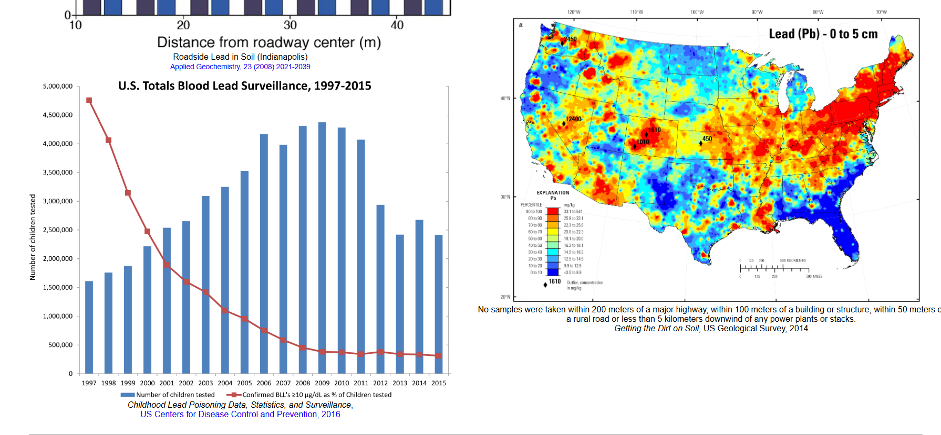
EPA Fraud in water system Science and Analysis Metallic and Ionic Lead in our water supply, in the
United States of America
Environmental Lead in America, Leaded Gasoline, naturally occurring in Soil
Notes:
https://chemistry.beloit.edu/classes/Chem117/lead/index.html
Source credits below graphs, legitimate sources. The Beloit site is just where I found the data
Left bar graph
Blue bars: Number of Children tested from 1.5 million to 4 million per year. Lots of kids, statistically relevant study.
Red line: Steady decrease in lead blood levels (number of children with BIL >/= to 10ug/dL)
1997 to 2015
Roughly correlated with the decrease of leaded gasoline use in America
Map of USA
Lots of lead underground in the USA (Red and Orange)
Plenty of lead in Wisconsin

Slide 12
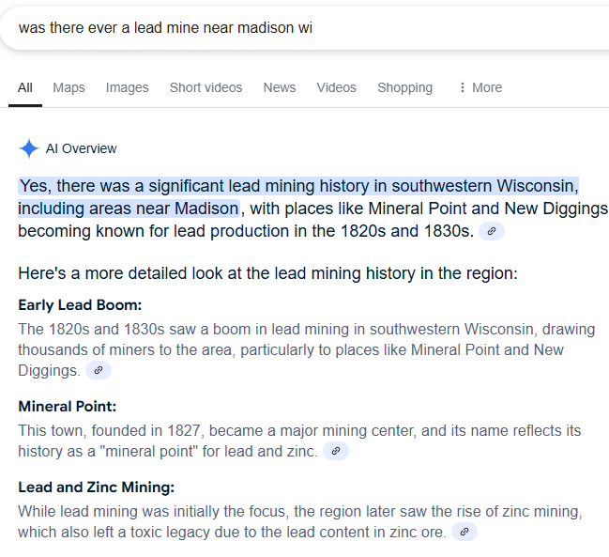
EPA Fraud in water system Science and Analysis Metallic and Ionic Lead in our water supply, in the
United States of America
Environmental Lead in Wisconsin, Near Madison WI
Notes:
AI search “Was there ever a lead mine near Madison wi
Point being, if lead is present under ground, we would expect to see it in well water.

Slide 13
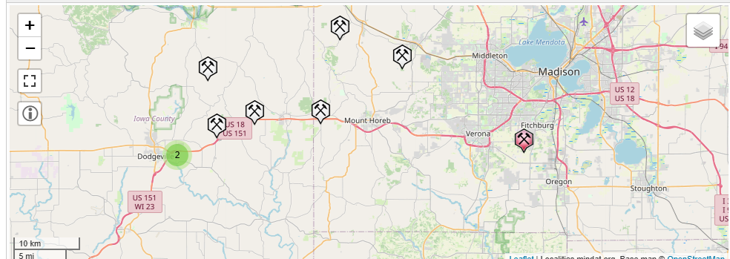
EPA Fraud in water system Science and Analysis Metallic and Ionic Lead in our water supply, in the
United States of America
Environmental Lead in Wisconsin Lead Mining near Madison WI
Point being, there’s a huge amount of Lead in the soil, under the soil, and likely, small amounts in the ground water. Don’t be upset or worried, our water is monitored frequently. The water system people are very good. The way we treat water (Anti corrosives) helps to guard against Lead. We have to be very careful about sampling method, and interpreting data with Lead in our water system to achieve competent ideology and results.
Notes:
https://www.mindat.org/locentry-917717.html “About” source https://www.mindat.org/a/aboutmindat
Interactive map (capable of zooming in/out, and adjusting locale) of confirmed Lead mines near Madison WI
Fitchburg borders Madison. We shouldn’t be surprised if/when lead shows up in ground (well) water, considering that lead was abundant enough to mine so close to Madison.
As well, considering the prevalence of mining, is it possible that there are lead spikes in wells from time to time?

Slide 14
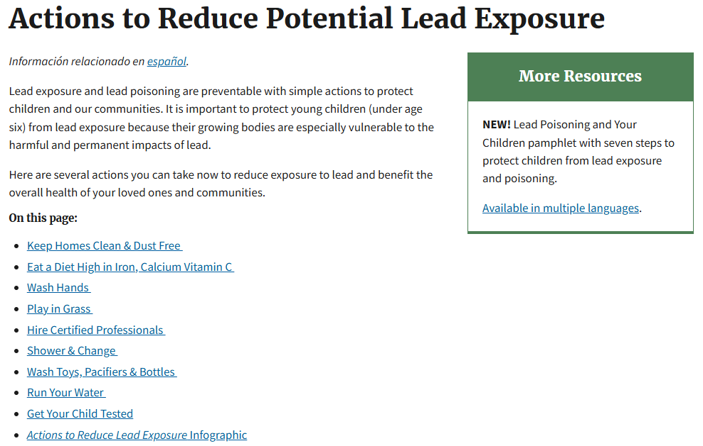


EPA Fraud in water system Science and Analysis Metallic and Ionic Lead in our water supply, in the
United States of America
Actions to reduce potential Lead Exposure (EPA)
The Environmental protection agency (EPA) clearly says:
Run your water
Shower/change
YET the EPA Sampling protocol for water studies from homes that:
Water is not run in the morning, MEANING, Stagnant sample, NO Shower, NO Flush
Aerator not cleaned and left in water stream (contributes lead)
EPA begins water studies with a FALSE HIGH LEAD CONTENT
Notes:
https://www.epa.gov/lead/actions-reduce-potential-lead-exposure
The EPA itself says drinking water is #8 on the list of things you could/should do to reduce your exposure to lead.
The two things that are most important for drinking water (Shower, run your water) ARE NOT PART OF THE EPA MANDATE ON DRAWING WATER FOR SAMPLE ANALYSIS.
The first six items are inexpensive to do!
Water system lead reduction can also be done cheaply, and effectively with very little expenditure, compared to lateral excavation and replacement.
With the proper emphasis on the proper ideology, this work could also be complete in a couple of years, vs. the 10 year plan in the BIL.

Slide 15


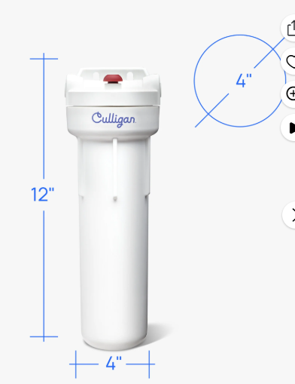
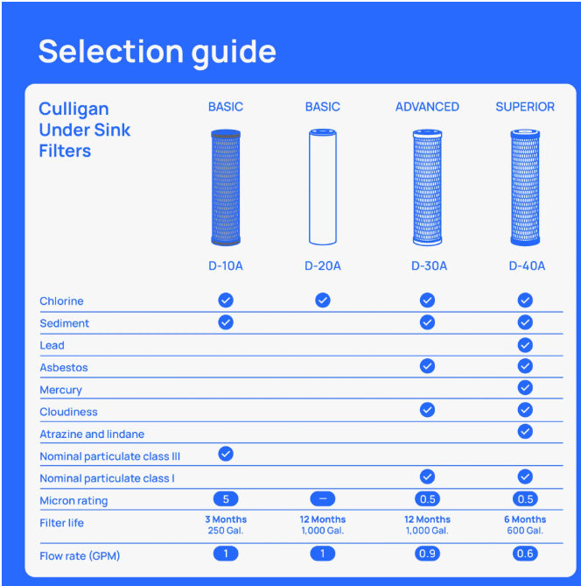
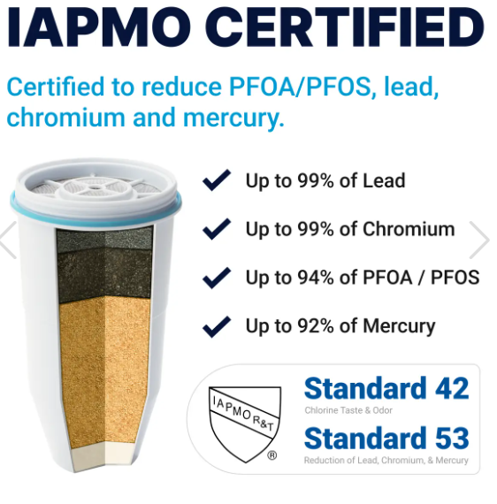
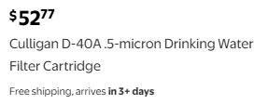












EPA Fraud in water system Science and Analysis Metallic and Ionic Lead in our water supply, in the
United States of America
Actions to reduce potential Lead Exposure (EPA), Filtration – Economical and effective
Notes:
Clean out aerator frequently (FREE WOO HOO!)
Under sink water filter
Culligan US-600A Housing - $31.85 https://www.walmart.com/ip/Culligan-Under-Sink-Drinking-Water-Filter-with-Cartridge/15552368?wl13=1176&selectedSellerId=0&wmlspartner=wlpa&gStoreCode=1176&gQT=1
Culligan D-40A filter (rated for lead) $52.77 https://www.walmart.com/search?q=culligan+D-40+water+filter
This filter alone will reduce lead substantially, likely near elimination
Zero Water (Culligan) filtration system. I like the seal on this unit (O-ring seal near top of filter). That’s a snug junction, and also on a stationary unit. Pitcher filters are OK, but I’m not fond of the filter being able to slip around as you use the pitcher. This unit is also nice for monitoring performance. If it takes a longer time to filter your water, you know your filter is loading, and it’s time to replace it. There’s a smaller/cheaper unit too.
https://www.zerowater.com/collections/all-water-filter-products
So, we have a lead rated under sink, high capacity 10 inch filter housing ($31.85), plus a higher rated filter than the included one ($52.77), plus a 52 cup ready read dispenser (comes with 2 filters, $64.99). Grand total = $149.61
4) Reverse Osmosis (RO) units are nice, and certainly get one if you want. I think most people will find that these two options (under sink filter, and filter reservoir) are Economical, easy to manage/install, and extremely effective. It’s nice to have 2 of them, which give you some surety in case one fails for some reason. Even better, stagger the filter change dates by ½ year. That way, the filters don’t age at the same time.
5) WELL, SINCE WE’VE SPENT SO LITTLE MONEY ON FILTRATION, LET’S GO WHOLE HOG AND GET A HEPA VACUUM TOO!

Slide 16
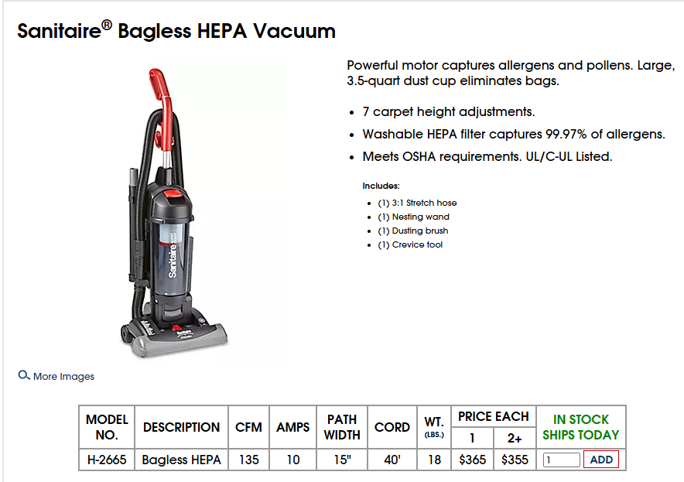




EPA Fraud in water system Science and Analysis Metallic and Ionic Lead in our water supply, in the
United States of America
Actions to reduce potential Lead Exposure (EPA)
Notes:
1) I liked this vacuum because the filter is washable/reusable, and it’s more of an industrial/commercial design. Little nervous about the crevice tool though : )
https://www.uline.com/Product/Detail/H-2665/Upright-Vacuums/Sanitaire-Bagless-HEPA-Vacuum?pricode=WA9442&gadtype=pla&id=H-2665&gad_source=1&gclid=Cj0KCQiA8q--BhDiARIsAP9tKI1Lf8vmwh8iJZW6Vjnadhk8qh9eF6_nZagXjFZQysxpfTEEPApR1W8aAleXEALw_wcB
Total for filtration = $149.61
Vacuum $365
Total $514.61
I’ll bet any of these *** clowns from the EPA that I can go into a home in Milwaukee’s interior, get this done within 2 hours (filters) and prove a Lead reduction in drinking water that is better than their stinking LSL replacement.
Moreover, the vacuum will greatly reduce the exposure that is most important Lead contaminant, Dust, and lead based paint. The HEPA (High Efficiency Particle air) is a nice filter.
After vacuuming, wipe down window sills, and floorboards, then seal them with caulk. Easy peasy.
By the way, you don’t need a stinking “Lead professional” to do this. You need someone from the neighborhood, someone people trust in their homes. You can easily get proper protective equipment. Please advise the EPA to stick their Lead professional up their Lead Pipe.

Slide 17
EPA Fraud in water system Science and Analysis Metallic and Ionic Lead in our water supply, in the
United States of America Key points in study:
Process Research Solutions and the EPA, together, tested homes for Lead in Madison WI
Process Research Solutions and the EPA agreed to a test sample protocol and data representation that intentionally deceived politicians and the public into believing that Lead levels were dangerously high due to Lead Lateral service lines.
3) City of Madison WI, Process Research solutions, and the EPA continued to report the Lead Lateral Replacement initiative as a success, when THEIR OWN data clearly showed that the lead reduction was:
  Minimal, Inconsistent, and Long delayed in Lead reduction, post Lead Lateral replacement
  Quantification was often in spurious range of tests (Limit of Quantification, Limit of Detection), Critically important information (Elemental/Metallic vs. Ionic) was not relayed.
  Decision making on the remedy for Lead in drinking water fostered the MOST EXPENSIVE and LEAST EFFECTIVE solution to mitigate/decrease Lead exposure in drinking water.
  Lead Lateral Replacement instead of Water Filtration or Reverse Osmosis
  5) City of Madison, WI Department of Natural Resources, and City of Evansville threatened residents with fines, and/or water shut off (in winter) as a penalty for non-compliance.
  The State of Wisconsin weaponized The Department of Natural Resources for enforcement.

Slide 18
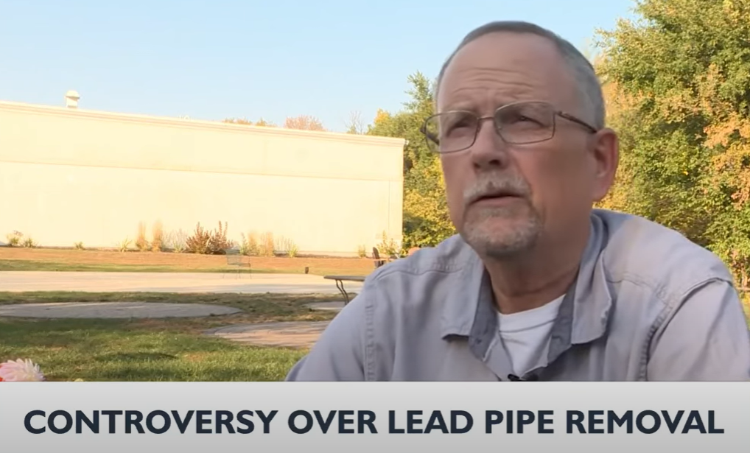
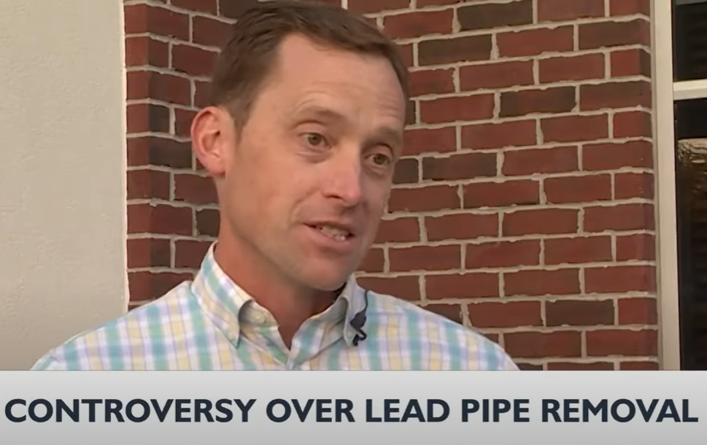

EPA Fraud in water system Science and Analysis Metallic and Ionic Lead in our water supply, in the
United States of America News Segment, aired on Channel 3, Madison WI, 10pm, October 10, 2024
(News 3 Now at Ten: October 10, 2024)
John Brandon
Citizen Scientist, Evansville WI
trinity7@tds.net
Evansville, WI
News Segment, aired on Channel 10, Madison WI, 10pm, October 10, 2024
https://www.youtube.com/watch?v=3Mdi3HCSIKk&ab_channel=Channel3000%2FNews3Now
Notes:
News Segment, aired on Channel 3, Madison WI, 10pm, October 10, 2024 (News 3 Now at Ten: October 10, 2024)
If the video is removed from Youtube for any reason, I have a backup copy stored in several places.
This News segment gives a brief summary, and some of the documentation of the mess in my City (Evansville Wisconsin) and the resultant desire of mine to get to the bottom of the Science and rationale behind the illegal police action and illegal threats of the Federal Environmental Protection Agency, and the
Wisconsin State government (Department of Natural Resources)
City of Evansville WI
to force people to pay to replace their Lead Service Laterals (LSLs)
https://www.youtube.com/watch?v=3Mdi3HCSIKk&ab_channel=Channel3000%2FNews3Now

Slide 19
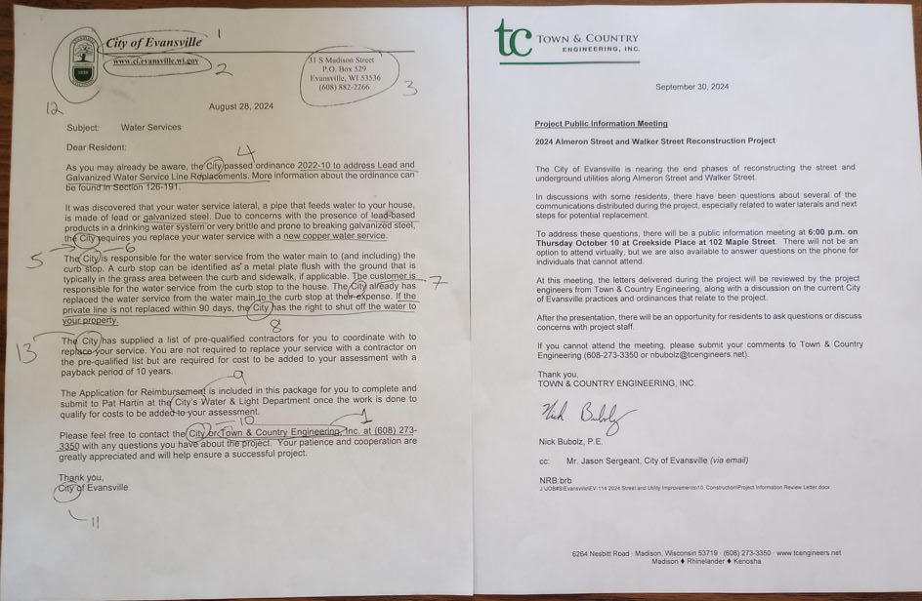
EPA Fraud in water system Science and Analysis Metallic and Ionic Lead in our water supply, in the
United States of America
Cowardly Moronic Letter (CML)
An example of a letter that Town and Country REALLY wrote.
Cowardly Moronic letter
Town and Country’s (engineering firm) Responsibility?
Notes:
How this all started:
We had road work on our street and a neighboring street in 2024. The initial information from the City of Evansville was that the LSL/Galvanized steel water supply would be OPTIONAL (letter in Youtube video, and a slide later)
Sept. 6 2024, the Cowardly Moronic letter (CML, Left Side). was taped to our doors This happened to roughly 23 residences on my street (Almeron Street), in Evansville, Wisconsin. My neighborhood is economically disadvantaged. Not only was our city threatening to shut off our water, but also this would put any scheduled shut off in December, which is expressly illegal in Wisconsin.
The City of Evansville has neither the jurisdiction, nor the authority to shut off water for any reason other than non payment, or emergency (repair). Even then, the customer can appeal to the Public Services Commission of Madison WI. The appeal is lengthy and detailed. This is to give the customer every opportunity to keep their utilities on.
My home was built in 1890. The City ripped out most of my west sidewalk and forced me to build a brand-new sidewalk on my south side, where none had existed for 130 years. Total = $4,800.
As mentioned in the video, my quote for lateral replacement was $3,500, bringing my total to $8,300. This was $8,300 in extra taxes, in one year. We were offered no money for compensation, whereas just last resurfacing project (2023), about 3 streets over recieved a $2,000 subsidy (Department of Natural Resources, Wisconsin).
Evansville Mayor Dianne Duggan, Evansville City Administrator Jason Sergeant, Evansville City Engineer Brian Berquist, Former head of Evansville City Council Cory Neeley, and Evansville City Councilman Jim Brooks have all maintained since Sept. 6 2024, that the letter on the left is the responsibility of Town and Country Engineering, who wrote the letter on the right.
The numbers on the Cowardly Moronic letter (CML) are the number of references to the City, the number 1 near the bottom is the sole reference to Town and Country, with “City” two words to the left.
There will be more detail on this later, and the respective chronology. It’s important to get to the science, and get the facts out to the people as soon as possible, pending corroboration

Slide 20
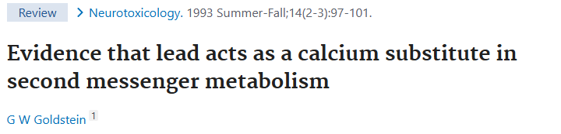

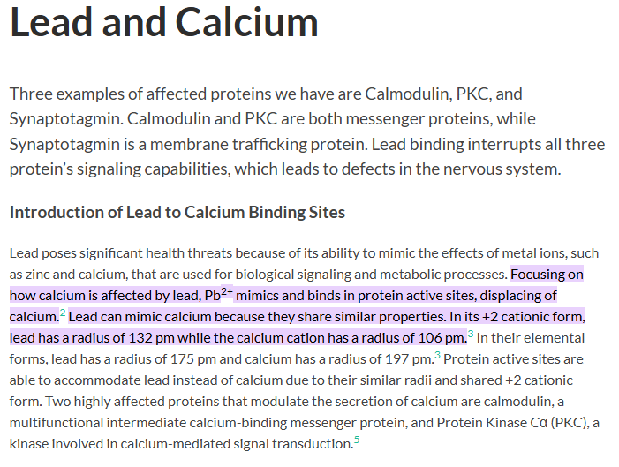
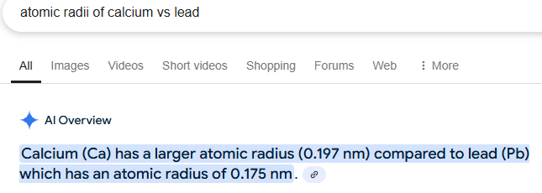
EPA Fraud in water system Science and Analysis Metallic and Ionic Lead in our water supply, in the
United States of America
Google inquiry: “Are lead and calcium similar?”
Notes:
Google “Are lead and calcium similar”
Neurotoxicology review:
https://pubmed.ncbi.nlm.nih.gov/8247416/
Tufts Edu lead and calcium
https://sites.tufts.edu/leadpoisoning/pathways/lead-and-calcium/#:~:text=Lead%20can%20mimic%20calcium%20because,a%20radius%20of%20106%20pm.&text=In%20their%20elemental%20forms%2C%20lead,a%20radius%20of%20197%20pm.
Unraveling….
https://pubmed.ncbi.nlm.nih.gov/37889332/

Slide 21
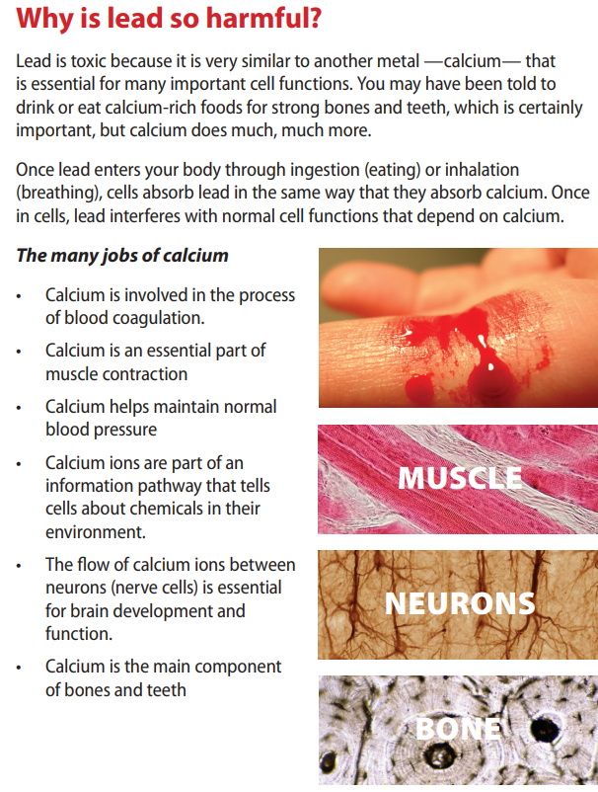
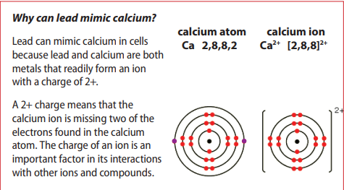













EPA Fraud in water system Science and Analysis Metallic and Ionic Lead in our water supply, in the
United States of America
NIE – Newspapers in Education pamphlet
It’s important to note that this is not a scientific study that is saying all of these bodily processes are affected by lead, or lead at a certain concentration.
They are saying that Calcium is very important in the body for many reasons, and that lead is an “analog” of Calcium.
https://nieonline.com/downloads/fighting_with_food/get_the_lead_out.pdf
Notes:
https://nieonline.com/downloads/fighting_with_food/get_the_lead_out.pdf

Slide 22









EPA Fraud in water system Science and Analysis Metallic and Ionic Lead in our water supply, in the
United States of America
NIE – Newspapers in Education pamphlet
Notice the absence of drinking water on the exposure paths?
https://nieonline.com/downloads/fighting_with_food/get_the_lead_out.pdf
Notes:
https://nieonline.com/downloads/fighting_with_food/get_the_lead_out.pdf

Slide 23
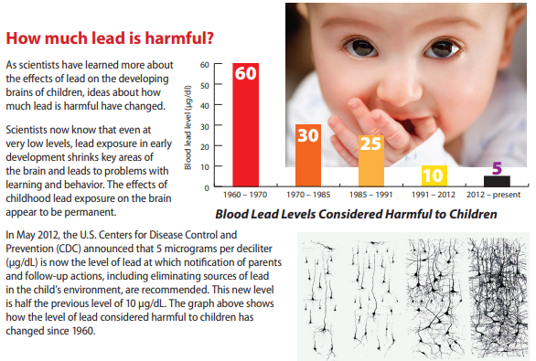
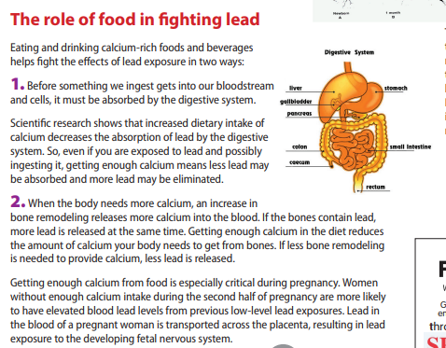












EPA Fraud in water system Science and Analysis Metallic and Ionic Lead in our water supply, in the
United States of America
NIE – Newspapers in Education pamphlet
Note the importance of ingestion/adsorption regarding ratio of Calcium to Lead
Keep in mind, exposure to Lead in infants is primarily through dust, notice the hand in the mouth. 5 ug/dl (microgram per deciliter) is 3.3 times the allowable level in drinking water.
Notes:
https://nieonline.com/downloads/fighting_with_food/get_the_lead_out.pdf

Slide 24
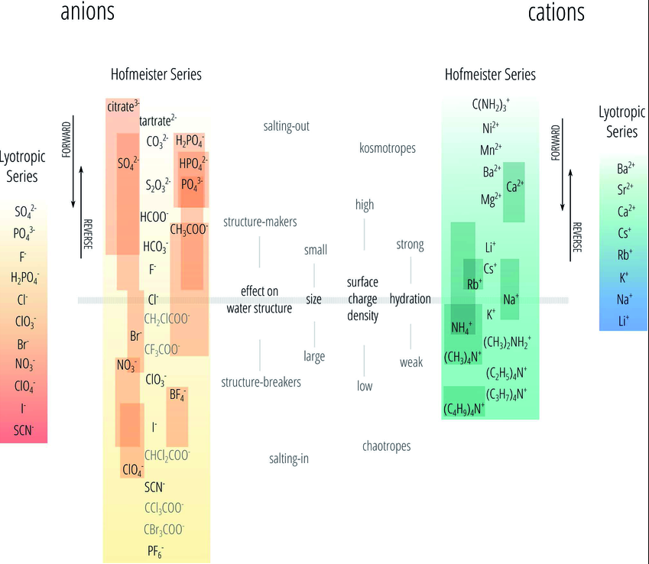
EPA Fraud in water system Science and Analysis Metallic and Ionic Lead in our water supply, in the
United States of America
Birds of a feather flock together (Hoffmeister Series)
Selected divalent Cation reference :
Phosphates
Mg3(PO4)2 (magnesium)
Ca3(PO4)2, Amorphous Calcium phosphate (Silt at the bottom of your glass, ACP), hydroxyapatite, bone
Pb3(PO4)2 (Lead Phosphate)
Sulfates
MgSO4 Epsom salt
CaSO4, Gypsum, drywall
PbSO4
Finally, the carbonates:
MgCO3
CaCO3, Chalk
PbCO3
Generally Insoluble “falls out of solution”
Pb
Generally soluble “stays in solution”
Pb = Lead
Ca = Calcium
Mg = Magnesium
Mn = Manganese
Notes:
Figure on the left: https://www.researchgate.net/figure/The-Hofmeister-and-lyotropic-series-of-ions-in-water-The-ions-of-the-Hofmeister-series_fig1_319223676
Key points,
Calcium salts and lead salts (Carbonate, Phosphate, Sulfate) all have low solubility (Form silt or chalky gunk, and fall out of solution).
Calcium and Lead are similar in size/strength (ionic charge)

Slide 25
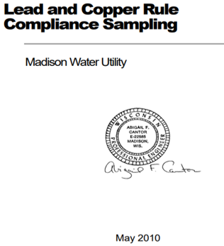
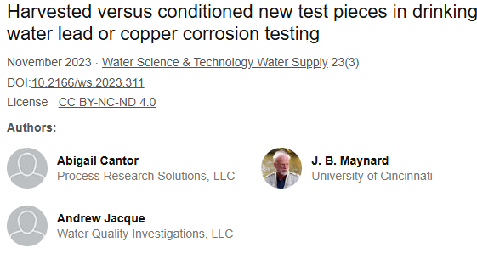
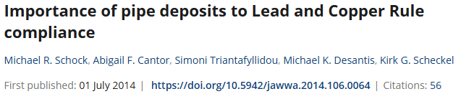




EPA Fraud in water system Science and Analysis Metallic and Ionic Lead in our water supply, in the
United States of America
In all of my years in Science (over 35 years Biotechnology, Molecular Biology, Pharmaceutical, Microbiology), I have NEVER seen work this poor. We paid for this work.
“Lead and Copper Rule Compliance Sampling” will be discussed in some detail. Remember that Science looks like a tree, in that you have a seminal paper, and subsequent technology branches and stems off of that. The system fails when false data is presented, and people build off of that.
It’s hard to understand why the City of Madison, and the State of Wisconsin believed this “data”.
Notes:
Abigail Cantor, et.al.
It looks like collaborative publications (Abigail Cantor with the EPA) stop in 2014 (Flint MI water crisis)
Was Abigail Cantor was a proponent of “eliminating chemicals” like corrosion control (Phosphates), and replacing lead pipes as corrosion control?
Were the EPA on board until the Flint water Crisis?

Slide 26
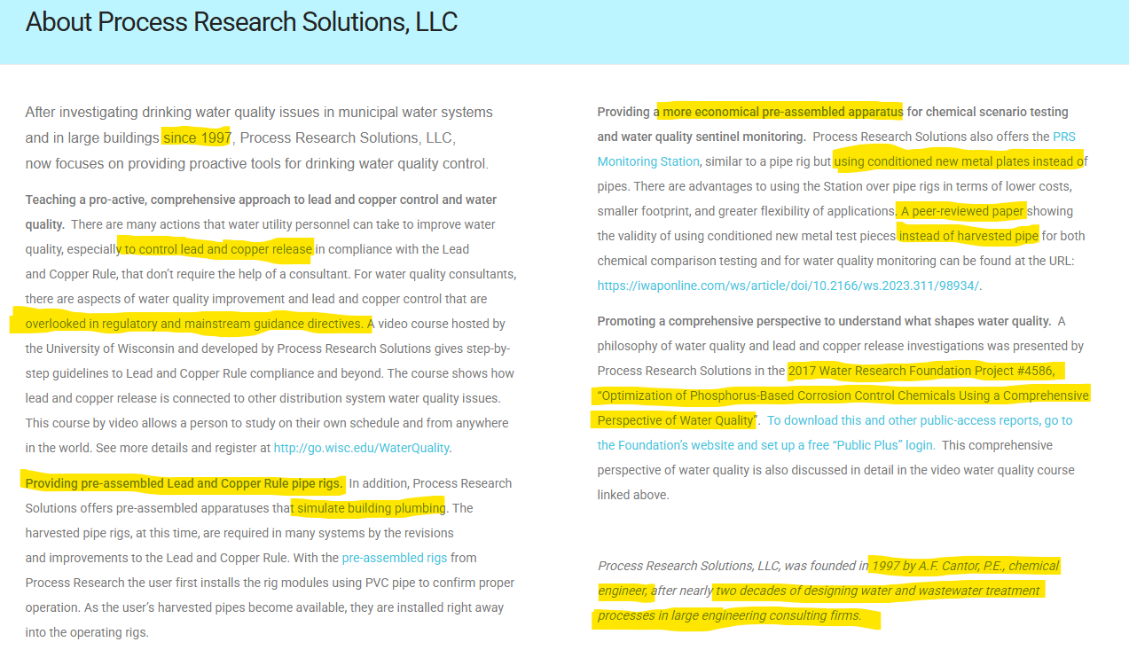
EPA Fraud in water system Science and Analysis Metallic and Ionic Lead in our water supply, in the
United States of America
Notes:
Abigail Cantor – Process Research Solutions, LLC
PO Box 5593
Madison, WI 53705
“About” link in Process Research Solutions website
Current, 01 Mar 2025
https://www.processresearch.net

Slide 27
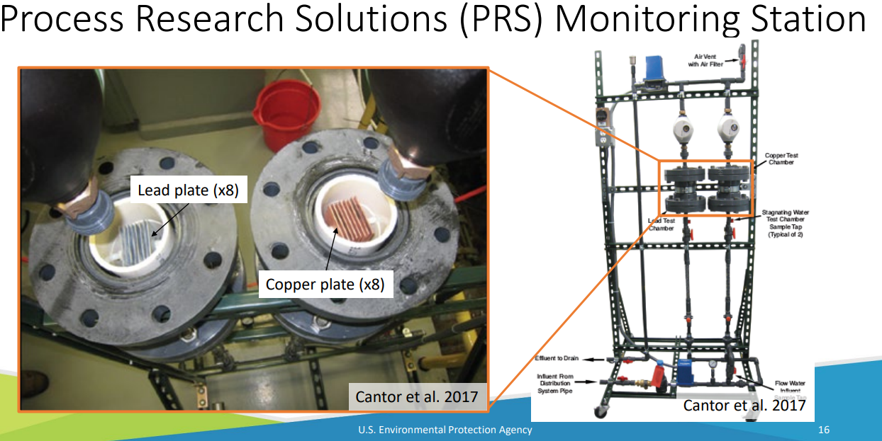
EPA Fraud in water system Science and Analysis Metallic and Ionic Lead in our water supply, in the
United States of America
file:///C:/Users/trini/Downloads/CORROSION%20TEST%20METHODS%20REVIEW%20OF%20BENCH%20TOP%20AND%20PILOT%20LEAD%20CORROSION%20ASSESSMENT%20STUDIES.PDF
Notes:
file:///C:/Users/trini/Downloads/CORROSION%20TEST%20METHODS%20REVIEW%20OF%20BENCH%20TOP%20AND%20PILOT%20LEAD%20CORROSION%20ASSESSMENT%20STUDIES.PDF
Picture of pipe rig used to simulate Lead Corrosion given different Corrosion inhibition chemicals, Abigail Cantor’s rig, EPA literature
This is a 2nd generation rig, with the cards in the pipe.

Slide 28
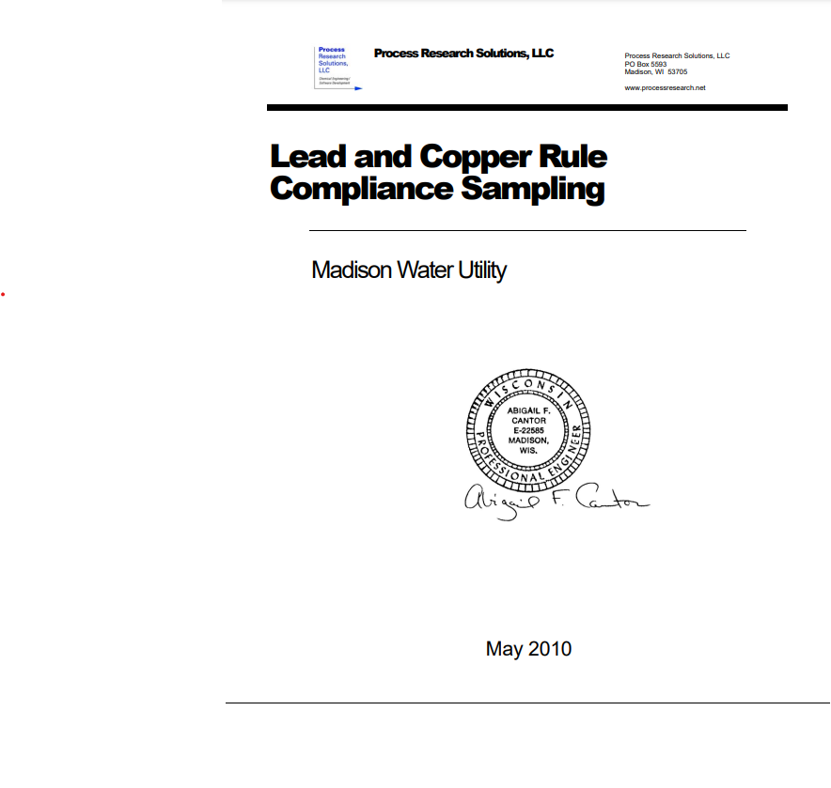
EPA Fraud in water system Science and Analysis Metallic and Ionic Lead in our water supply, in the
United States of America
Lead and Copper Rule Compliance Sampling
The review of this work is pretty “sciency” regarding the text, assumptions, and the outcome of the work/thought. The most important data are on slides 34, 35, and 36 (Lead graphs, initial start, and over time post Lead Lateral replacement.
https://www.cityofmadison.com/water/documents/2010LCRSamplingACfinal.pdf
Notes:
https://www.cityofmadison.com/water/documents/2010LCRSamplingACfinal.pdf
Abigail Cantor – Process Research Solutions, LLC
PO Box 5593
Madison, WI 53705
https://www.processresearch.net
1991 – LCR new 15ppb Lead Federal allowable level (From previous 50 ppb)
1992 – Madison WI lights up at 16ppb lead
1997 – Process Research solutions founded
2000 – Madison WI starts LSL replacement
2010 – This report (Lead and Copper Rule Compliance Sampling)
2011 – Madison WI finishes LSL replacement
2014 – Flint MI water Crisis

Slide 29
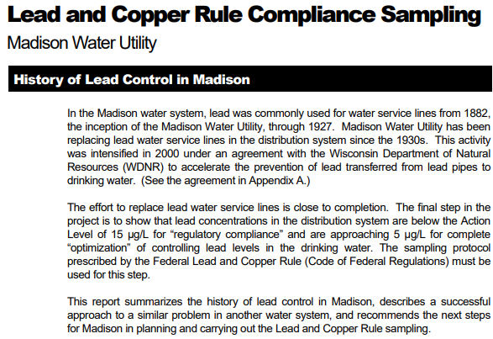
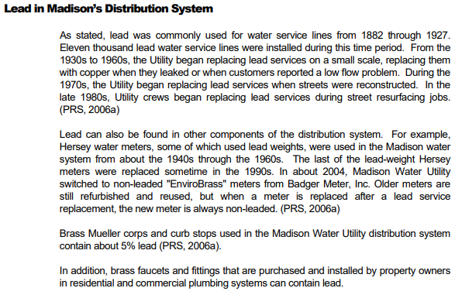





















EPA Fraud in water system Science and Analysis Metallic and Ionic Lead in our water supply, in the
United States of America
Lead and Copper Rule Compliance Sampling, Abigail Cantor, Page 3
This is a “white paper” in that it does not undergo scientific scrutiny by a board, or any other individual. Abigail Cantor has put her Professional Engineer seal on the document.
This is a “review” in that it pulls from academic journal articles, or unpublished results. Generally, one publishes a review when the subject matter is mature, or if it would be beneficial to scientists to have multiple sets of current thought, together, for ease of comparison.
Notes:
Wisconsin Department of Natural Resources (WNDR) figures heavily in:
Treating Citizens of the State of Wisconsin terribly in terms of
Creating a new police enforcement activity (The pipe police?)
Threatening with fines, and water shut off
Nefarious changing of grant award money from my community, mid stream
Telling Citizens “There’s no money”.
Throughout this document, the Scientific literature, and government proceedings, you see, Abigail Cantor, the EPA officials (Michael Schock, Simoni Triantafyllidou, Michael Desantis, Kirk Scheckel), and the Wisconsin Department of Natural Resources.
Later in “Lead and Copper Rule Compliance Sampling”, you see City of Madison Charter, and City documents showing the creation of a “Water Authority” position, from the Wisconsin Department of Natural Resources
Curiously absent, is any thought or knowledge base, and fundamental water system experience from the division of State Government, that oversees:
1) Water
2) Electricity
3) Gas
The Public Services Commission
That’s a very curious thing. More on that later
https://www.cityofmadison.com/water/documents/2010LCRSamplingACfinal.pdf Page 3

Slide 30
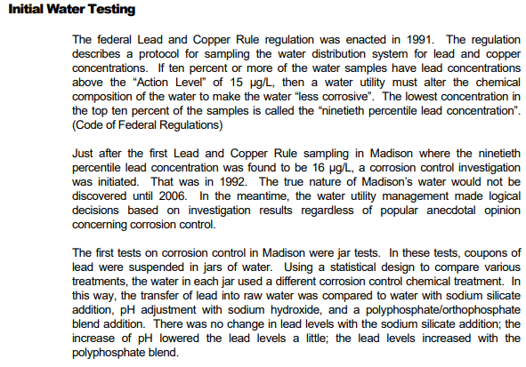
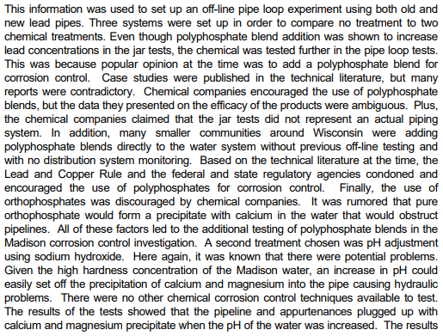















































EPA Fraud in water system Science and Analysis Metallic and Ionic Lead in our water supply, in the
United States of America
Lead and Copper Rule Compliance Sampling, Abigail Cantor, Page 4
1
2
4
2
3
5
6
4
7
7
8
9
10
Notes:
https://www.cityofmadison.com/water/documents/2010LCRSamplingACfinal.pdf Page 4
“True nature of Madison’s water” – This is good writing. She’s got something new and exciting coming up.
“Logical decisions….popular anecdotal opinion” This is excellent writing again. This is a jab at the current thinking. She is equating the existing thought, experience, trending, and knowledge base to popular anecdotal opinion. In other words, She’s a bit smarter than everyone established in the Water Quality System. They are the dinosaurs, and she’s cutting edge.
“Jar Tests”, Statistical design. This is where things started to smell funny. Jar tests would give you a yes or no answer, in a stagnant environment, which would never occur in a water system. The whole point of a water system is to keep it moving. Lines that branch and are not used (Dead ends) are the death knell of any water system. Stagnancy in water analysis is only appropriate if you’re studying a pond. Statistical design likely refers to setting up experiments using DOE (Design of experiment) software. It’s useful in the right hands, but minimally useful when you have an inappropriate model. In other words, “Statistical design” means I’m trying to impress someone who doesn’t know what they’re doing.
Polyphosphate, and polyphosphate/Orthophosphate blend are used frequently in water processing. There’s lots of names for poly phosphate, like polymer, etc. Abigail Cantor says the polyphosphate INCREASES the LEAD in her experiment, then doubles down and mentions it again for emphasis.
If you have a model/result that is different from accepted theory, you don’t report it, you troubleshoot it. You certainly don’t report it in a review. You go back to your model and see what went wrong. Unless, you don’t understand what went wrong……
More condescending crap, this time to Chemical Companies. Chemical companies help me in my work. They have data, technical people who help me figure out things, and are generally quite courteous, even if your question doesn’t sell them a product. “Ambiguous Efficacy” – This is BS. No one posts contradictory scientific data on the efficacy of their product. She is saying that the chemical company is shooting itself in the foot with it’s own experimental results. It looks like Abigail Cantor may not understand the data they present. “Jar tests did not represent actual piping system”. Well, no duh.
Bagging on smaller communities for not testing polyphosphate prior to using it.
“It was rumored that pure orthophosphate would form a precipitate with calcium” Yes, I’ve heard that rumor. It stated in problems sets I worked through in Freshman Chemistry. Calcium readily precipitates with phosphate. So do Magneisum, and lead. Phosphate is a really good thing to have around, as a co-precipitant to both Calcium and lead. That way it falls out of solution, and you become less likely to drink it. You see Calcium phosphate show up in literature on waste water analysis. It’s called ACP, or Amorphus Calcium Phosphate. This is critically important later. As well, when in precipitated form, the phosphates are easily filtered.
”pH adjujstment with sodium hydroxide, high pH problems”. Most of the drinking water literature is consistent regarding higher pH being favorable in prevention of pipe corrosion. Everyone knows that intuitively. High pH is like baking soda, which is OK on metal. Low pH is acid, or sour, and can corrode metal. Like muriatic acid (synonym for Hydrochloric acid). Like Sulfuric acid (Battery acid), like bleach (Sodium Hypochlorite). Very corrosive. Bad for metal, bad for pipes.
“Precipitation of Calcium and magnesium, causing hydraulic problems”. This observation is very strange. This could only happen if the water in the pipe rigs were changed repeatedly without the pipes being cleaned. It’s pretty shocking that they’re not looking at the lead in the precipitate, vs. released lead. In this literature, you seldom see anything distinguishing ionic from elemental, nor discussion on the relevancy thereof. That type of data is in verbiage, but they don’t show numbers.
appurtenances – “an accessory or other item associated with a particular activity or style of living”. I didn’t know pipes had appurtenances. Had to look that word up.

Slide 31
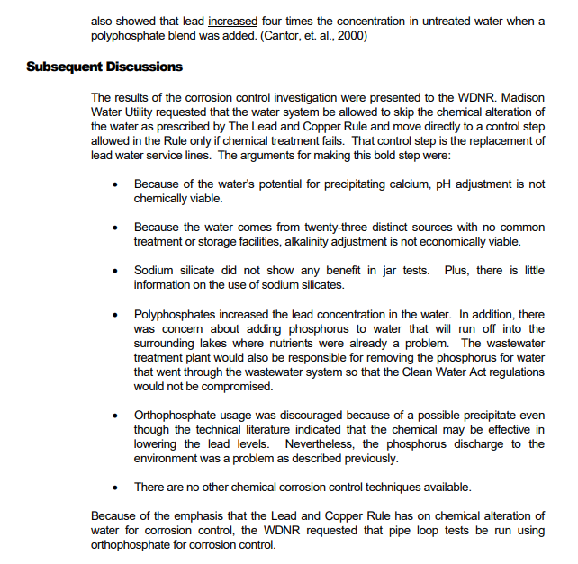
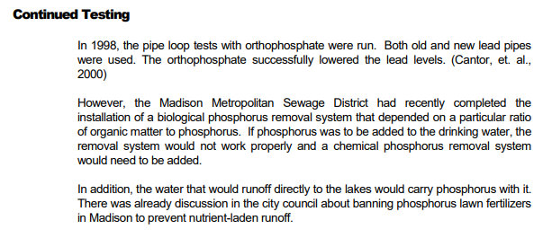















EPA Fraud in water system Science and Analysis Metallic and Ionic Lead in our water supply, in the
United States of America
Lead and Copper Rule Compliance Sampling, Abigail Cantor, Page 5
1
4
2
3
4
1
Notes:
https://www.cityofmadison.com/water/documents/2010LCRSamplingACfinal.pdf page 5
4) Kept the number four, transferred from the last page that mentioned Polyphosphate increasing lead (two times). Polyphosphate here 2 times, for a total of four times in two pages.
It looks like they’re advocating no phosphorus, but also say that orthophosphate decreases lead. Precipitate of lead is a good thing. You want Lead insoluble.
Sounds like they’re taking Poly, and/or orthophosphate out of the drinking water processing. If they did that, I wonder if that was when they were getting Color/Manganese/Iron in the drinking water?
EPA/DNR/Cantor all want to ban phosphorus?

Slide 32
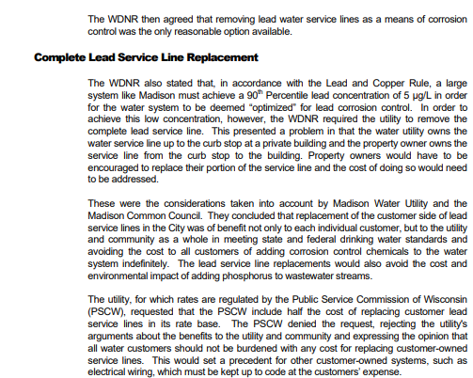
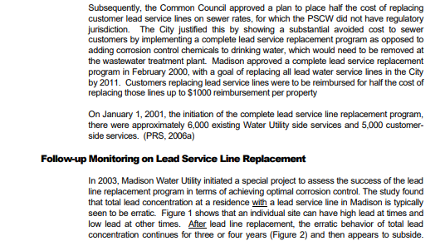

























EPA Fraud in water system Science and Analysis Metallic and Ionic Lead in our water supply, in the
United States of America
Lead and Copper Rule Compliance Sampling, Abigail Cantor, Page 6
1
4!
2
3
4!
5
Notes:
https://www.cityofmadison.com/water/documents/2010LCRSamplingACfinal.pdf page 6
Several problems here. Why is the Wisconsin Department of Natural resources regulating what is in the pipe, rather than the Public Services Commission, which has jurisdiction, authority, expertise, and experience? Why is the WNDR pulling a number out of their *** that is different from the Federal Allowable level, without justification in the Science? Why on earth would you use the term “optimized”?
“Encouraged” comes up in the DNR/City of Evansville letters early on. “Encouraged” became “mandatory” (like in the video segment), or we shut your water off, in December. Isn’t it great to have a government POLICE FORCE that’s so in tune with water quality?
Madison Water Utility? Is that the Public Services Commission? Is it the new DNR “Water authority”? They’re saying Later replacement (LSL), “Good for the Customer”, “Good for the community”, “Good for the Utility” TRIPLE WIN
VERY IMPORTANT This is Process Research Solutions, and the EPA’s goal. They want to eliminate phosphorus from waste water streams. Good rationale? Is corrosion control the only thing phosphorus does in our water?
Is phosphorus beneficial as a buffer?, keeping the pipes from experiencing acidic conditions and corrosion?
Why do they think Corrosion control is not necessary for Copper?
Does phosphate precipitate Lead? Yes, it does. Therefore, lead is much less likely to be consumed.
How does a Chemical Engineer not know these things?
Environmental impact – https://www.cleanlakesalliance.org/state-of-the-lakes/ 2023, Lake Monona (Madison, WI) rated Excellent for Phosphorus, and Good for Clarity. Oh, here’s another thing,
Synonyms for Phosphate:
Sodium Phosphate (Dibasic, and monobasic)
Disodium Phosphate, monosodium Phosphate
Orthophosphate (single phosphate ion)
Corrosion chemical
Phosphorus
Inorganic Phosphorus
Scientists love synonyms. Make it less likely that we’ll be replaced by monkeys. Point being: Phosphate is in just about every processed food and drink. That means excess phosphate is excreted to wastewater.
Then you have livestock and farming runoff….
A typical Soy/Corn fertilizer is 18/18/18. That’s percent Nitrogen/Phosphorus/Potassium.
https://www.cleanlakesalliance.org/wp-content/uploads/2020/05/2021-State-of-the-Lakes-Report-Compressed.pdf (estimates 16,500 POUNDS of phosphate to lake Monona from farm run off.
Did they try eliminating Phosphate/corrosion control in Madison’s drinking water?
What was the cost and environmental impact of eliminating corrosion control in Flint Michigan, in 2014? Did they get the idea from this paper?
5) Classic technique for science BS. Put text prior to the data. Separate the data from the text. Best way to conceal that you have crappy data. Admit it, but be sly.

Slide 33
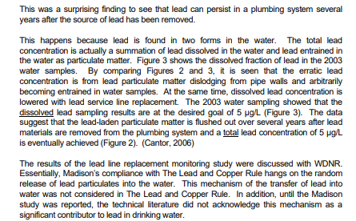
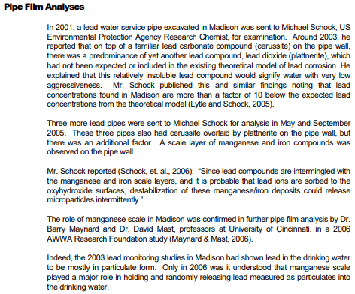



























EPA Fraud in water system Science and Analysis Metallic and Ionic Lead in our water supply, in the
United States of America
Lead and Copper Rule Compliance Sampling, Abigail Cantor, Page 7
1
Wow! Another page of exquisite writing, prior to showing data! How fortuitous that there’s so much to say………………..
4
2
3
Dissolved vs. particulate
Ionic vs. metallic
Salt vs. inorganic
Oxidized vs. elemental
Mix or match, all say the same thing. Lead in solution (like Dissolved, Ionic, etc., like a salt), or
Lead as metal/inorganic (like iron filings) can be easily filtered. EPA doesn’t seem to know that, nor does a Chemical Engineer. Strange
5
Notes:
https://www.cityofmadison.com/water/documents/2010LCRSamplingACfinal.pdf Page
“It was surprising finding to see that lead can persist in a plumbing system several years after the source of lead has been removed”. Yes, I can see how that might be surprising, considering how you just made Madison WI replace 9,000 pipes for a whopping 30ish million dollars.
“Erratic Lead” The root of Erratic is Err, or Error. “Arbitrarily becoming entrained”. That’s Scientific Academy Award writing. If you give an arbitrary mechanism, for arbitrary data, then the arbitrary data is “explained”. Get it?
Hey, now the Department of Natural Resources agrees. We got buy in from the Bear/Moose/Deer/Fish people. We’re going with “random release of Lead”
Pipe film Analysis – One of Michael Schock’s papers will be later. Mr Schock (EPA) says, “lead concentrations found in Madison are more than a factor of 10 below the expected lead concentrations from the theoretical model (Lytle and Schock, 2005). What that means, is that they were expecting much larger release of Lead from the pipes, but weren’t seeing it. That means, Lead is coming from somewhere they either don’t know, or won’t say.
Again, and admission that the lead in drinking water is primarily Particulate/Metallic/inorganic. That means, it’s not potent biologically, and that it can be easily filtered out of drinking water. Wow Cantor/EPA. Just WOW.
SO, EPA/CANTOR do not recommend the LEAST EXPENSIVE/MOST EFFECTIVE OPTION OF FILTRATION. Rather, they continue to recommend the MOST EXPENSIVE/LEAST EFFECTIVE method of Lead/Galvanized steel lateral water supply replacement.
This paper is 2010,
Flint Water Crisis, Shock’s paper (EPA), and yet another Madison City Infomercial (EPA seeks details of Madison’s Lead Service Replacement Program) are in 2014
Intriguingly, Cantor/Maynard/Mast part company with the EPA in 2014 with regard to publishing. Do you think that may have been because one, or the other, wanted to distance themselves from the potential that Madison had no corrosion control (phosphate) in the water supply for a period, under the “recommendation” of Cantor/EPA/WDNR? This is a suspicion of mine. This work seems to indicate that direction of thought.

Slide 34
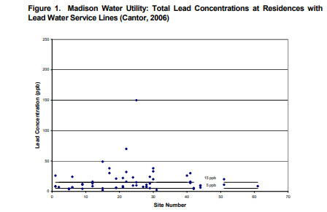


EPA Fraud in water system Science and Analysis Metallic and Ionic Lead in our water supply, in the
United States of America - Lead and Copper Rule Compliance Sampling, Abigail Cantor, Page 8
Lead levels at time Zero, Madison WI
Time Zero estimate:
AT/ABOVE Fed. Allowable limit
~21/48 points: at or above the Fed Allowable level of 15 ppb
BELOW Fed. Allowable limit
~21/48 points: 5ppb to 15 ppb
~6/48 points: less than 5 ppb, the “optimized limit”.
~27/48 (56%) points are Federally allowable
BAD
More than 15 ppb
BAD
More than 15 ppb
GOOD 15 ppb or less
GOOD 15 ppb or less
Notes:
https://www.cityofmadison.com/water/documents/2010LCRSamplingACfinal.pdf Page 8
Figure one, barely mentioned at the bottom of Page 6 (two pages ago).
Keep in mind, it is being said that this data substantiates the point that the laterals are causing lead levels in excess of the Federal allowable Limit of 15ppb.
First of all, why the Scatter? Does that increase data confidence?
Previously Abigail Cantor mentions Statistical methods in setting up Jar experiments (static samples)
Where is the statistical work here?
Typically we express confidence in our data with a ratio. It’s called confidence, R squared, correlation coefficient, again with the synonyms….
This data would have low confidence. The scatter is not explained.
Another data trick of questionable science, CONTRACT THE SCALE OF SUSPECT DATA. That makes the points below 5 ppb hard to see.
~27/48 points start out below the Federal Allowable limit of 15 ppb (Roughly 56%). That’s why the “OPTIMIZED” level is lower at 5ppb. They don’t want to point out that at the beginning of their study, the MAJORITY OF POINTS WERE BELOW THE FEDERAL ALLOWABLE LIMIT OF 15 ppb. IN OTHER WORDS, THE MAJORITY OF LEAD PIPES GAVE LEVELS OF LEAD BELOW THE FEDERAL ACCEPTABLE LIMIT.
This is a big principle in Science. Correlation does not imply causation. Much like the pipe rig data that supposedly showed that polyphosphate increases lead:
You cannot explain the 6 data points below the “optimized” level of 5ppb
Unless you THINK
Do any of those homes have an elderly person, or a small child who gets up in the early morning. It’s really hard to un-flush. That Lead would be in/near a bathroom, or in the sewer
OR, have you ever gotten up in the middle of the night and heard Sssssssssssssssssssshhhhhhhhhclunk? That’s your toilet reservoir filling after water seeped under your flapper valve. That would definitely explain the “Optimized” level of Lead showing up in the initial data points.
Either, or both of these scenario’s explain the starting data which is well below the “Optimzed” level of 5ppb Lead.
Now, the author can’t use a valid explanation, because if she does, people will say, “so, we can just run the water?” The answer is, YES
So, we can tell the average American, continue using the restroom first thing in the morning to reduce your exposure to lead under the “Optimized” level. Even better yet, take a shower.
Yes, you already do that.
No one grabs a liter of water first thing in the morning and drinks it.
No one drinks the brakish water that first comes out of a fountain, sink, hose, or whatever. By nature, we like the FRESH WATER. And that, folks, explains the starting amples below 5 ppb.
But, neither Abigail Cantor, or the EPA want you to know that.
The reason for that is, their revenue is proportional to the Public Outcry for Clean Drinking water
If the drinking water is actually clean, then their revenue dries up (please excuse the Dad Joke, I couldn’t resist)

Slide 35
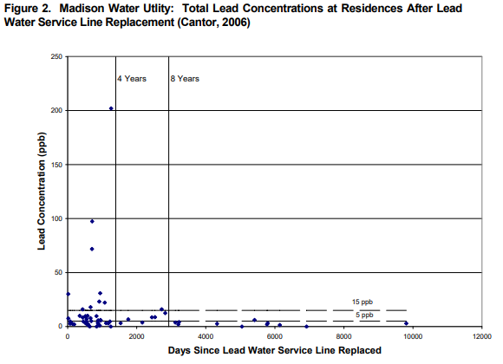
EPA Fraud in water system Science and Analysis Metallic and Ionic Lead in our water supply, in the
United States of America Lead and Copper Rule Compliance Sampling, Abigail Cantor, Page 8
It’s difficult to say this, but this graph means that you were wrong regarding:
Lateral replacement reduces Lead
2006 was also the year that Madison started Unidirectional flushing of mains. This was well documented to decrease lead in Marshfield WI in 2006 as well.
10,000 days/365 days per year
= 27 years, yet publication date is 2006?
This is another example of intentional deception. Be clear about what your X axis in terms of WHAT IS THE DATE.
Origin is 1992?
1
Notes:
https://www.cityofmadison.com/water/documents/2010LCRSamplingACfinal.pdf Page 8
Again, improper scale for graph. What year is the origin? You want to see a zoom in around the origin. That’s interesting data, that they don’t explain, except for the BS Manganese/Iron Scale argument with the “Random Release” of Lead”.
2) Why were there not EPA cries for help and emergency on the points that were well above the previous Federal Allowable limit of 50 ppb? There’s one above 200 ppb (~ 13 times the Federal allowable limit for Lead). What was that? They continually ignore data that doesn’t meld with what they are trying to push. Is this what they’re talking about when they say “testing outside the Lead and Copper rule”? In other words, are they saying that levels above the federally allowable limit are OK, provided that the EPA is responsible for the Lead levels being high?
To Simplify:
EPA Cries wolf (LEAD) on drinking water
EPA pulls number out of their heinie for Lead, post Lateral replacement (5 ppb Lead), then can’t meet that number
EPA increases funding to study and address Lead problem, and mandates the taxpayers pay out of their own pocket to replace laterals
EPA excuses high levels of lead following their blunder.
EPA directs state government to do all of the work, and enforcement, on Lateral Line Replacement
Nice Racket

Slide 36
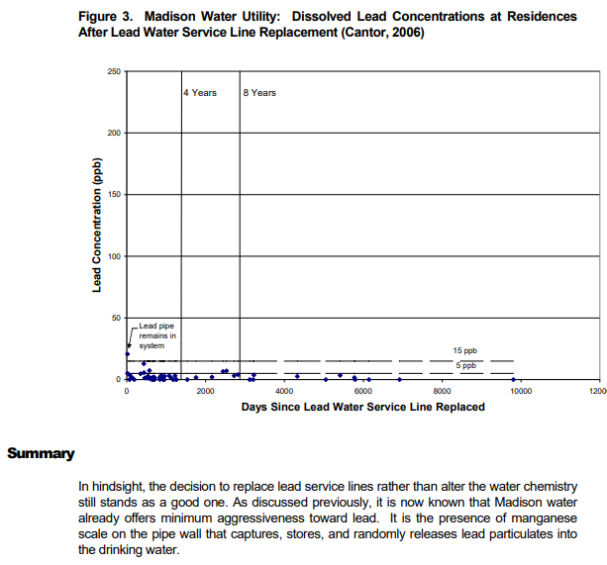








EPA Fraud in water system Science and Analysis Metallic and Ionic Lead in our water supply, in the
United States of America - Lead and Copper Rule Compliance Sampling, Abigail Cantor, Page 9
Dissolved (ionic) much, much less than particulate, yet Abigail Cantor, the EPA, and the WNDR cry LEAD!!!!
Summary:
This is really a WOW statement.
The decision to spend over 30 million dollars based on terrible science was a good one
The decision to reach into the pocket of the citizens again, over and above the taxes we already pay, was a good one.
Not doing obvious filter trials, that’s a good decision.
All with the admission that the pipes are minimally aggressive toward Lead.
WOW
Notes:
https://www.cityofmadison.com/water/documents/2010LCRSamplingACfinal.pdf Page 9
Again (and again), having a graph where you can’t superimpose the relevant data (Metallic/inorganic/Particulate vs. Dissolved).
It seems like this is the data that they used to say that Lead is predominantly particulate in Drinking water, but they don’t show the data or calculation.
Again (and again) with the Capturing and random release. Sheesh.
Can the dissolved lead be oxidized lead in the aerator that is trapped? Seems likely.

Slide 37
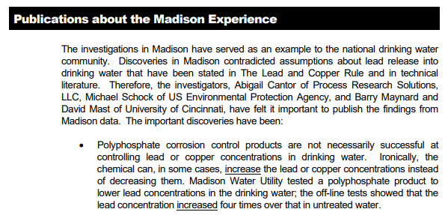
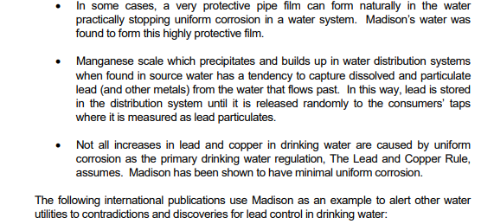



















EPA Fraud in water system Science and Analysis Metallic and Ionic Lead in our water supply, in the
United States of America - America Lead and Copper Rule Compliance Sampling, Abigail Cantor, Page 9-10
CONCLUSIONS
1
3
2
4
5
Notes:
https://www.cityofmadison.com/water/documents/2010LCRSamplingACfinal.pdf Page 9 and 10
OK, here’s where everyone talks turkey, returning to the “True Nature of Madison’s Water” that Abigail Cantor alluded to in her opening address
“An example to the national drinking water community”. Agreed here, this is a fantastic example of a group of people getting together, deciding that the EPA and the WNDR need people/funding to fulfill their mission. Are they taking decisions regarding our most precious resource (water) out of the hands of those who have experience, knowledge, and expertise (The Public Services Commission), to those who have “new ideas” (Process Research Solutions, Environmental Protection Agency, Wisconsin Department of Natural Resources).
b) Abigail Cantor, (Civil Engineer, Masters in Chemical Engineering), Michael Schock (Chemist, EPA), and Barry Maynard/David Mast (University of Cincinati), are all on board.
In my count, this is the fifth time Cantor has mentioned PolyPhosphate as not being successful in removing lead, or increasing lead in her pipe Rig experiment I’ll detail that in the next 2 slides.
“Very protective pipe film”, “highly protective film” – This comes from Michael Schock’s work. We’ll review a 2014 paper of his later. It does beg the question, If you have a very protective pipe film, or a highly protective film, why are you messing with it? WHY THE HELL ARE YOU MAKING PEOPLE REPLACE PIPES WHEN THAT SUBJUGATES THEM TO 4-8 YEARS OF LEAD LEVELS IN DRINKING WATER THAT ARE FAR IN EXCESS OF THE FEDERALLY ALLOWABLE LIMIT??????
“lead is stored in the distribution system until it is released randomly”. Random release, Arbitrary mechanism of release, We know it happens, but can’t explain it. Therefore, our “findings” and “discoveries” cannot be challenged. Random and Arbitrary can work in your favor, if you’re Abigail Cantor, The Wisconsin Department of Natural Resources, or, The Federal Environmental Protection Agency. That’s some fortuitous science there. Wouldn’t it be a great thing if we could use “Random and Arbitrary” as an excuse at work? “Gee Boss, I would have met that deadline, but for random and arbitrary circumstances”.
“Not all increases in lead and copper in drinking water are caused by uniform corrosion”. That’s an interesting statement. I can’t recall any data presented on Copper in this work. What does it imply? Does it imply that there may be lead coming from the well? Where is it coming from? “Madison has been shown to have minimal uniform corrosion”. Is this justification for eliminating phosphate or polyphosphate from water processing? I would love to know if they did this, and when they did this if they did. That would answer a lot of questions.

Slide 38
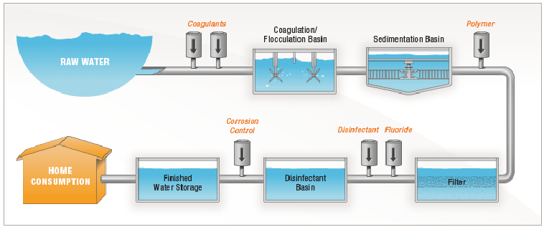
EPA Fraud in water system Science and Analysis Metallic and Ionic Lead in our water supply, in the
United States of America
Denver Colorado Drinking water process flow
1
Aluminum sulfate
Polyphosphate
3
2
5
5
Ortho phosphate
Chloramine
4
https://www.denverwater.org/your-water/treatment-process
Notes:
https://www.denverwater.org/your-water/treatment-process
Most pumping in a water system is primed effectively, by being submerged or fed properly. This is important because it keeps oxygen low in the water, which prevents bacterial growth, and solidifies corrosion control.
As an example, water towers/elevated reservoirs feeding supply systems, using gravity to feed final distribution.
Pumps can gulp, or hammer. Both create pressure increases and decreases, which promote gas bubble formation (oxygen) in the water. Air pockets are bad in pipes. Air/Gas pockets in pipes promote corrosion.
2) Flocculation and sedimentation get the majority of the big stuff out, and also reduce bacterial load.
Polymer/polyphosphate addition. This is important.
Polyphosphate helps in Iron color reduction (complexes Iron). This is a primary complaint of customers (Red/Brown water).
Polyphosphates act as "sequestering agents," meaning they bind to iron ions, preventing them from oxidizing, or forming insoluble precipitates, e.g., rust-colored compounds that cause stains/color.
4) Filter, usually sand, often activated carbon (fancy charcoal)
5) Disinfectant, Chlorine, or Chloramine most often.
6) Orthophosphate corrosion control

Slide 39

EPA Fraud in water system Science and Analysis Metallic and Ionic Lead in our water supply, in the
United States of America PolyPhosphate, Pipe rig, Process Research Solutions
Problems with pipe rig (Cantor’s rig that “proved” polyphosphate increases Lead):
Pump not specified. Pumps cause turbulence (Cavitation and shear). You don’t want that in water systems, because you introduce “gulps” (Cavitation) and rapid changes in positive pressure (Shear). Many/Most water systems use a tower, or elevated reservoir to feed the distribution system. Letting gravity do your distribution aids in keeping down oxygenation, and keeping the water from fouling. Oxygen and corrosion are hand in hand.
Recirculation. This doesn’t happen in water systems. If there is a loop, it’s long, and the water is re-treated prior to another distribution.
Polyphosphate observation. Polyphosphate is a flocculating agent. One sees Polyphosphate addition primarily prior to filtration in water systems. It’s important for complexing Iron, which is really important for color reduction. Polyphosphate also helps in keeping the filter media from clogging (Sand). I use a related chemical in my work. You have to be careful to not beat the hell out of it (like with pump action). It breaks down. You want it intact to help form protective surfaces, as it has a waxy, gummy texture. It’s irresponsible to publish information that says lead is increased by Polyphosphate, when your testing system is outside of the way Polyphosphate would be used normally in a drinking water system.
Testing. What about EDTA/EGTA studies (complex a variety of metals)? What about bacterial testing? Oxygenation and minerals promote bacterial growth. That can influence the water by driving the pH down. Where’s the pH data?
Notes:
file:///C:/Users/trini/Downloads/CORROSION%20TEST%20METHODS%20REVIEW%20OF%20BENCH%20TOP%20AND%20PILOT%20LEAD%20CORROSION%20ASSESSMENT%20STUDIES.PDF
Picture of pipe rig used to simulate Lead Corrosion given different Corrosion inhibition chemicals, Abigail Cantor’s rig, EPA literature
This is a 2nd generation rig, with the metal (lead) cards in the pipe.

Slide 40







EPA Fraud in water system Science and Analysis Metallic and Ionic Lead in our water supply, in the
United States of America Accumulation of debris, ACP (Amorphous Calcium phosphate) Polyphosphate
Elemental/particulate/Metallic needs Oxygen (air) and water to become Ionic
Notes:
This is my kitchen sink aerator. The debris is at least four years old.
Beneath the red plastic layer is a two mesh (interwoven metal wire) screen.
The fine layer of white silt you see in the bottom of a glass of drinking water is Amorphous Calcium Phosphate (ACP). Remember, lead is very similar to Calcium, and can form analogous material.
In an aerator, debris and ACP (and lead equivalent) can form layers that harden with repeat drying. Also, polymer residual can help to coat and keep adding to trapped debris, over time.
Since Lead is an analog of Calcium, small levels of lead accumulation in an aerator are expected. The EPA and Abigail Cantor ignore this in publications. This could explain their residual data, coupled with Unidirectional flushing of water mains.
Furthermore, since and aerator performs aeration, this is the most likely place for Lead Oxides in the water stream/supply to form. The aerator is the MOST likely place to form the MOST dangerous form of lead, yet, both the. EPA and the WNDR approve of this sampling method using aerators. Sounds like they wanted to find lead, and did what they had to do to make sure the level was high, ignoring the fact that people flush/shower prior to drawing water.
Everyone agrees it’s great to clean aerators by reverse flow.
The EPA’s sampling method insists on keeping the aerator on, and sampling the first liter of water (e.g., prior to a flush or shower), thus obtaining the scariest/highest Lead concentration possible, totally discounting normal human behavior in a residence (water use patterns).

Slide 41
EPA Fraud in water system Science and Analysis Metallic and Ionic Lead in our water supply, in the
United States of America Shell game: Metallic and Ionic Lead
Critical in the Science, is that the 2 main forms of metal are vastly different. This example uses Iron, but the same principle applies to lead.
For Lead, Ionic/oxidized/Soluble is dangerous because it is easily digested (adsorbed into the body)
Particulate/metal/insoluble is much, much less dangerous, in that it is difficult to digest.
EPA/WDNR/Scientific community all agree that most of lead in the water system IS PARTICULTE, and thus can be easily filtered out. Water systems use anti corrosives (phosphates) to reduce oxidation of metal. (lead and iron), which prevents Ionic forming.
Ionic
Metallic
Notes:
This is the most important fact about lead in the water system. It’s at a very low level, and primarily metallic/particulate.
This slide is repeated because the picture tells the story very well.

Slide 42





EPA Fraud in water system Science and Analysis Metallic and Ionic Lead in our water supply, in the
United States of America EPA sampling method for homes in Lead Analysis
Aerator heresy, likely culprit for lead levels being high, and intermittent.
Abigail Cantor differs with the EPA sampling method, yet publishes data using said sampling method.
NOW, Abigail Cantor says that Lead is UNDER REPRESENTED by having an aerator that captures lead particles?
NOW, Abigail Cantor says that the aerators could be harboring lead from the distant past, accumulated, which contradicts the previous statement.
“Data will be analyzed”: This is rather cryptic. There’s no mention of what this means, or where the data is located, or what test is recommended. What does outside the Lead and Copper rule mean?
Notes:
https://www.cityofmadison.com/water/documents/2010LCRSamplingACfinal.pdf Page 19
The last statement is very difficult to understand. Keep in mind, this is over 20 years after the first 16 ppb “lead scare” in Madison. They are saying they don’t know the difference in lead with/without aerators, and haven’t tested for it. That’s leaving an intense variable unexplained, in a study that has a major impact on the public.
This is difficult to say, but this is really poor science. It’s also irrational use of public money. We have a water system that works, and they are poking holes in it. The motive is the same as any crime drama, they want the money, and you don’t get the money unless you have a problem, or manufacture a problem.

Slide 43











EPA Fraud in water system Science and Analysis Metallic and Ionic Lead in our water supply, in the
United States of America
1
2
3
Notes:
https://www.cityofmadison.com/water/documents/2010LCRSamplingACfinal.pdf Page 19 and 20
Random release from Manganese and Iron Scales again. This is even better than the Polyphosphate increasing lead by 4 times. This sounds harsh, but if you’re a real scientist, you don’t repeat this kind of BS. If you suspect something like this, you investigate the wells, and start doing studies that are different than what you’re undertaking.
Unidirectional Flushing as a protocol to reduce Lead below the federal limit of 15ppb, but, we’re going to keep on strong arming, and mandating extra money from Citizens, out of their own pockets, to pay for lateral replacement.
Here’s the WDNR again. They have review power over a “publication” from a supposed independent engineering firm, who is also very tight with the EPA. One happy family.

Slide 44










EPA Fraud in water system Science and Analysis Metallic and Ionic Lead in our water supply, in the
United States of America
1
2
3
Notes:
https://www.cityofmadison.com/water/documents/2010LCRSamplingACfinal.pdf Page 12
Wow. Clear data that Unidirectional flushing (water mains) gets you below the Federal allowable limit of 15 ppb (ug/L). Again with the deceptive graph. The triangle is the 90th percentile. That’s the most relevant data. There’s only one point above the Federal Allowable limit, but no thought as to why the spike occurred. The high standard deviation (Maximum large, Average small) signifies that the high point may be aberrant.
How did the Madison experience pave the way toward water understanding? Did everyone stop using Polyphosphate and Orthophosphate, and start doing flushing/lateral replacement as the only corrosion control? Did the entire USA change the way they processed water due to this work?
If Lead can be transferred by a number of mechanisms, why were roughly 21 of 48 tests in the initial data, which were below the Federal allowable limit for Lead?

Slide 45


















EPA Fraud in water system Science and Analysis Metallic and Ionic Lead in our water supply, in the
United States of America Summary
1
2
3
4
Notes:
https://www.cityofmadison.com/water/documents/2010LCRSamplingACfinal.pdf Page 17
WDNR, Madison Water Utility? Water Authority? 3/23/2010, All Agreed?
No Chemical treatment? Does this mean no PolyPhosphate? Does it mean no Orthophosphate? When was this done, or was it done?
Lateral replacement, “Significant source of Lead”, again, admitting lateral replacement reduces, but does not eliminate lead (50-75% ?). What the author fails to mention is that the reduction takes 4-8 years post replacement.
Admits Marshfield Data, where the Lead was. below the Federal Allowable limit with Unidirectional flushing alone (No mandatory LSL replacement). The “Random Release” theory is repeated ad-nauseum.

Slide 46












EPA Fraud in water system Science and Analysis Metallic and Ionic Lead in our water supply, in the
United States of America Wisconsin Department of Natural resources – Pipe police
Notes:
https://www.cityofmadison.com/water/documents/2010LCRSamplingACfinal.pdf Appendix A (WDNR)
Wisconsin Department of Natural Resources (in their published addendum to the study)
Winning the hearts of the people of Madison WI

Slide 47












EPA Fraud in water system Science and Analysis Metallic and Ionic Lead in our water supply, in the
United States of America Wisconsin Department of Natural resources – Pipe police
Notes:
https://www.cityofmadison.com/water/documents/2010LCRSamplingACfinal.pdf Appendix A (WDNR)
Wisconsin Department of Natural Resources (published addendum in Cantor’s white paper)
Winning the hearts of the people of Madison WI

Slide 48

EPA Fraud in water system Science and Analysis Metallic and Ionic Lead in our water supply, in the
United States of America Wisconsin Department of Natural resources – Pipe police
Lead pipes?
Unfortunate home-owners?
Notes:
https://www.cityofmadison.com/water/documents/2010LCRSamplingACfinal.pdf Appendix A (WDNR)
Wisconsin Department of Natural Resources
Winning the hearts of the people of Madison WI

Slide 49














EPA Fraud in water system Science and Analysis Metallic and Ionic Lead in our water supply, in the
United States of America: Journal of American Water Works Association
EPA?
https://awwa.onlinelibrary.wiley.com/hub/journal/15518833/scope
Notes:
https://awwa.onlinelibrary.wiley.com/hub/journal/15518833/scope
A considerable amount of publishing from the water industry associated with Lead and Copper Rule comes from this journal. These articles are peer reviewed, which could possibly mean that the peer review committee could be stacked with EPA individuals. That would be interesting information.

Slide 50










EPA Fraud in water system Science and Analysis Metallic and Ionic Lead in our water supply, in the
United States of America Journal of American Water Works Association
Importance of Pipe deposits to Lead and Copper Rule compliance
https://awwa.onlinelibrary.wiley.com/doi/10.5942/jawwa.2014.106.0064
1
Same year as Flint Water Crisis!
2
Notes:
https://awwa.onlinelibrary.wiley.com/doi/10.5942/jawwa.2014.106.0064
Unfortunately this work is tied up in intellectual property. This means that the article contents cannot be cut/pasted/transferred. In other words, the public gets to pay for the work, but the public cannot use the work, or critique the work. Note that this is in a “Peer Reviewed” journal. Given this work, and others from the Journal of American Water, is it possible that the EPA figures heavily in content and review?
The Abstract serves as a summary of the content, and the intent of the work. You want to lead and terminate with your most important information in an abstract.
“Full LSL replacement in Madison achieved Lead and Copper Rule compliance”. Not true. LSL replacement initiated a 4-8 year period when Lead levels were elevated (Slide 34), followed by a period where Lead was “in compliance”. Furthermore, even with the improper sampling method, more than ½ of the lines were initially compliant with the Federally allowable limit of lead.
“Supplemented by Unidirectional flushing”. Again, misleading, as Marshfield WI achieved full compliance to the LCR (15 ppb, ug/L Lead) solely through unidirectional flushing, WITHOUT LSL replacement.
Major reduction in Lead contamination and exposure. Again, not true. The EPA’s own figures say LSL excavation and replacement reduces lead by 50-75%. This is achieved through a flawed sampling protocol, that includes lead accumulation in the aerator of taps/faucets.
This paper represents a pivot, in that the EPA needs to explain their assertion with Abigail Cantor, that the “Random release”, and “Arbitrary mechanism” of lead in the drinking water is due to something that is difficult to understand, rather than an artifact of taking stagnant samples the first thing in the morning, and thus reporting a false high on lead content in the water. In the Science industry, we call this “Hand waving”. Hand waving is close to conjecture.
Table one in text of the paper text, contains complex mineral analysis of Madison Drinking water originating from representative wells (3, 6, 14, and 19). It’s really good data, and I wish I could post it. Take home point is that water from wells, even in a similar location, is quite variable in mineral content. The troubling thing about this data, is that there is NO MENTION OF LEAD IN THIS TABLE. REMEMBER THAT, IT”S IMPORTANT.
If your data says NO LEAD detected”, in the wells, then you state it. That would be your negative control in the study
However, if there is lead detected in the well water, you don’t want to let your readers know that. That would explain lead contamination in the scale layers in the pipes.
Furthermore, I strongly suspect, when they ran mass balance, they realized that all of the lead accumulation in the pipe could not have come from the pipe wall. Otherwise, lead pipes would never last 100 years. It’s a soft metal. Would the pipes would dissolve to nothing if all of the lead in the scale, and in the drinking water, came from the pipes?
There is a graph (Figure 1), which shows 90th percentile figures of Lead, 1992-2013.
The graph clearly shows lead levels above the federal allowable limit in 2003 (3 years after lateral replacement)
There is no data for 2006, when the unidirectional flushing began
Data for 2010 (10 years after lateral replacement) is about 10ppb (ug/L), which is below the federal allowable limit of 15
The reason for the Lead reduction is stated to be THE LATERAL REPLACEMENT, rather than UNIDIRECTIONAL FLUSHING OF MAINS, when the Flushing alone was responsible for Marshfield WI meeting the LCR level of 15ppb.

Slide 51










EPA Fraud in water system Science and Analysis Metallic and Ionic Lead in our water supply, in the
United States of America: Authors of “Importance of pipe deposits to Lead and Copper Rule compliance”
https://www.epa.gov/sites/default/files/2018-08/documents/schockmichael_biosketch_wsd.pdf
Notes:
https://www.epa.gov/sites/default/files/2018-08/documents/schockmichael_biosketch_wsd.pdf
1) Lead Author’s page in the EPA. Water system sampling and analysis up front. Remember that there were differences in sampling acumen, and that the “agreed upon” sampling method was drafted by the EPA. This sampling method created a false erroneous initial high lead content, that would never be seen in a home with normal drinking water patterns.

Slide 52








EPA Fraud in water system Science and Analysis Metallic and Ionic Lead in our water supply, in the
United States of America: Authors of “Importance of pipe deposits to Lead and Copper Rule compliance”
https://19january2021snapshot.epa.gov/sites/static/files/2019-03/documents/triantafyllidousimoni_biosketch_wsd.pdf
Notes:
https://19january2021snapshot.epa.gov/sites/static/files/2019-03/documents/triantafyllidousimoni_biosketch_wsd.pdf
1) Simoni Triantafyllidou, Environmental Engineer, EPA, contributing author for “Importance of pipe deposits….”

Slide 53












EPA Fraud in water system Science and Analysis Metallic and Ionic Lead in our water supply, in the
United States of America: Authors of “Importance of pipe deposits to Lead and Copper Rule compliance”
Notes:
Mike DeSantis, EPA, Physical Scientist – Contributing author, Importance of Pipe deposits……..

Slide 54





EPA Fraud in water system Science and Analysis Metallic and Ionic Lead in our water supply, in the
United States of America: Authors of “Importance of pipe deposits to Lead and Copper Rule compliance”
Notes:
Kirk G. Scheckel, EPA, Research Soil Scientist – Contributing author, Importance of Pipe deposits……..
It’s a shame that there’s someone in the EPA who understands bioavailability of Lead, yet that information does not come out in publications.

Slide 55
EPA Fraud in water system Science and Analysis Metallic and Ionic Lead in our water supply, in the
United States of America: Authors of “Importance of pipe deposits to Lead and Copper Rule compliance”
Why are there no medical doctors as authors?
Because they will know the difference in bioavailability between
Why are there no biochemists, or medical research specialists?
Because they will know the difference in bioavailability between
Why aren’t the people who run our water systems, who have the hands on knowledge not included?
Because they will know where the Lead is coming from
Because they will know that Cantor’s work is BS (Pipe rigs, polyphosphate observations)
Because they will know that the sampling method is solely designed to elevate lead
Because they will know that no one drinks a liter of water first thing in the morning
Metallic and Ionic Lead in our water supply
Metallic and Ionic Lead in our water supply
Notes:
Kirk G. Scheckel, EPA, Research Soil Scientist – Contributing author, Importance of Pipe deposits……..
It’s a shame that there’s someone in the EPA who understands bioavailability of Lead, yet that information does not come out in publications.

Slide 56

EPA Fraud in water system Science and Analysis Metallic and Ionic Lead in our water supply, in the
United States of America: “Importance of pipe deposits to Lead and Copper Rule compliance” Conclusions
There’s a lot of mention of scale layers, metal composition of layers, and relative solubility of the layers relative to Lead, in whatever form.
The important thing, and this reverberates through all EPA and WDNR, and Cantor’s work,
THE LEAD IS PARTICULATE
Lateral replacement ONLY REDUCES LEAD (50-75%)
PARTICULATE LEAD CAN BE FILTERED TO NEAR 100% Efficiency! Well, they never say this in this work, but the EPA says filters can remove lead in many other communications.
MARSHFIELD WI achieved full federal compliance: WITHOUT LATERAL REPLACEMENT WITH UNIDIRECTIONAL FLUSHING OF MAINS
This paper specifically mentions that they think a significant amount of lead is in the Scale, which is a “sink” for lead, and that the scale is undoubtedly is in the interior plumbing of homes. That means that the next “regulatory focus” will be the EPA trying to get into homes, and forcing people to replace interior plumbing.
Notes:
https://awwa.onlinelibrary.wiley.com/doi/10.5942/jawwa.2014.106.0064

Slide 57
EPA Fraud in water system Science and Analysis Metallic and Ionic Lead in our water supply, in the
United States of America: “Importance of pipe deposits to Lead and Copper Rule compliance” Conclusions
The sampling is first draw, first liter, with aerator (flawed, False High)
“Lateral replacement…..can eventually eliminate the significant particulate lead concentration found in the faucets”
NOT TRUE The lead persists for a very long time (4-8 years), furthermore, Lead appears in well water.
“However, it took time-in some cases, more than four years-for the accumulated lead to be released and then additional time for re-equilibration with the “new” relatively lead-free water”
This is an extremely important statement. This is why there’s no mention of Lead in the initial table that has the complex mineral analysis of several Madison wells. The reason they don’t mention the lead, is that the concentration of lead in the wells is “relatively” lead free. That means Lead is there, and that explains why the deposits form. That is also why it’s very important to have chemical corrosion control (Phosphate, and Polyphosphate) in water treatment.
Notes:
https://awwa.onlinelibrary.wiley.com/doi/10.5942/jawwa.2014.106.0064

Slide 58


EPA Fraud in water system Science and Analysis Metallic and Ionic Lead in our water supply, in the
United States of America: “Importance of pipe deposits to Lead and Copper Rule compliance”
Conclusions
“However, it took time-in some cases, more than four years-for the accumulated lead to be released and then additional time for re-equilibration with the “new” relatively lead-free water”
This also underscores the importance of setting up filtration in homes, especially in areas where Lead is plentiful in the soil.
Ground shifts. Well water is variable. It’ nice to have a safety mechanism that isn’t dependent on detection or testing of Lead. Better yet, two (under the sink filter, and reservoir filter).
Notes:
https://awwa.onlinelibrary.wiley.com/doi/10.5942/jawwa.2014.106.0064

Slide 59
EPA Fraud in water system Science and Analysis Metallic and Ionic Lead in our water supply, in the
United States of America Recapitulation of Key points in study: Overall conclusions
Process Research Solutions and the EPA, together, tested homes for Lead in Madison WI
Process Research Solutions and the EPA agreed to a test sample protocol and data representation that intentionally deceived politicians and the public into believing that Lead levels were dangerously high due to Lead Lateral service lines.
3) City of Madison WI, Process Research solutions, and the EPA continued to report the Lead Lateral Replacement initiative as a success, when THEIR OWN data clearly showed that the lead reduction was:
  Minimal, Inconsistent, and Long delayed in Lead reduction, post Lead Lateral replacement
  Quantification was often in spurious range of tests (Limit of Quantification, Limit of Detection), Forms of Lead in drinking water not addressed (Elemental/Metallic vs. Ionic)
  Decision making on the remedy for Lead in drinking water fostered the MOST EXPENSIVE and LEAST EFFECTIVE solution to mitigate Lead exposure in drinking water.
  Lead Lateral Replacement instead of Water Filtration or Reverse Osmosis
  5) City of Madison, WI Department of Natural Resources, and City of Evansville threatened residents with fines, and/or water shut off (in winter) as a penalty for non-compliance.
  The State of Wisconsin weaponized The Department of Natural Resources for enforcement.

Slide 60
EPA Fraud in water system Science and Analysis Metallic and Ionic Lead in our water supply, in the
United States of America Recapitulation of Key points in study: Overall conclusions
  I shudder when I think of all of the money that’s been spent on people replacing their laterals. Tax money, plus forcing people to pay a large quantity out of their own pockets.
1) In my neighborhood alone, there were 4-5 homes that spent their own money after being threatened with water shut off, with NO GOVERNMENT HELP, when you constantly read about the vast quantities of Money for Lead at the State and Federal level.
2) Coercing people to pay for Laterals consecutive with road work, after being forced into extra taxes for sidewalk repair or construction is egregiously bad government. If I had replaced my Galvanized Steel lateral after being threatened, my total expenditure would have been $8,300, which is roughly equivalent to the City of Evansville mandating that I pay my property tax, and then over 3 times that amount as an extra tax.
The Scientific review of the Madison Water Authority (not to be confused with the Public Services Commission), and the Wisconsin Department of Natural Resources is either inept, or, severely lacking in ethics.
The “Scientists” who pushed for the Lateral replacement, and published off of it, are very selfish, and militant toward the public. We in the Scientific community greatly desire to further our field, and serve the public. This brings myself and my colleagues who serve, great shame.

Slide 61
EPA Fraud
In Water System Science and Analysis
Metallic and Ionic Lead
in our water supply, in the
United States of America
What the EPA is doing now
What the EPA will do if/when it gets into the homes of the USA
John Patrick Brandon
Citizen Scientist
04/20/2025
460 Almeron St.
Evansville WI 53536
trinity7@tds.net

Slide 62










EPA Fraud in water system Science and Analysis Metallic and Ionic Lead in our water supply, in the
United States of America Sequence of Events in Evansville WI, and documentation Apr 04, 2024
“Wishing” to replace their Lateral
“Encouraged” to contract
“Allow” homeowners
Optional!!
“Wishing” to replace their Lateral
“Encouraged” to contract
“Allow” homeowners
Turned out to be a LIE
Notes:
We were given our assessments for Sidewalks. We were told that only cracked/damaged panes would be replaced. That turned out to be a lie as well. About 85% of the sidewalk was replaced, primarily because that makes the replacement of the mains, and the lateral up to the curb stop easier for the Engineers/Road Crew.
So, we get charged twice on that. We foot the price for the road work being easier from our own pockets, and also the taxes. The City mandates that we pay ½ the cost of the Sidewalks, out of pocket, in addition to the City’s portion, which is paid for from our property taxes. I live on a corner, and they forced me to build/pay for a long sidewalk, when there had not been one for over 130 years. My home was built in 1890. This also took a significant portion of my property for the City easement.

Slide 63









EPA Fraud in water system Science and Analysis Metallic and Ionic Lead in our water supply, in the
United States of America Sequence of Events in Evansville WI, Cowardly Moronic Letter (Sept. 06, 2024)
Cowardly:
No one had the guts to sign it
No one had the guts to mail it
Authors refused to take responsibility for it
No one had the guts to visit my street and explain themselves
Threat was made to a vulnerable neighborhood
Moronic:
Cited ordinance is illegal (no authority, no jurisdiction)
Cited ordinance is 30 day, whereas the text says 90 days
Date on letter different from date of delivery
Legal notices must be delivered through mail or by hand
Bipartisan Infrastructure law says WATER SYSTEMS must replace laterals, not end users
Notes:
So, I came home from work on Friday Sept. 6th, 2024, to find this “letter” taped to my door.
Monday Sept. 9, 2024, Joy Morrison (former Alderperson) went to City Hall, and expressed concern over this letter, stating emphatically how irregular it was as a City communication.
Cowardly:
1) The letter was anonymous. No one signed it. That’s cowardly
2) The people who are responsible for the letter (Evansville City Administrator Jason Sergeant, Mayor Diane Duggan, Municipal services committee, Evansville common council) have blamed another (Town and Country Engineering)
No one believes Town and Country (T&C) is responsible for this letter.
There’s an email that I gave out on the Oct 10th meeting that says it was released for distribution from the City. Jason Sergeant is copied there.
4) It was “sent” to very vulnerable people. Cowardly people threaten the weak
5) There was no offer of financial assistance, to a needy neighborhood. Please enjoy your pool and lazy river (9 million dollar project), while you punish my neighbors for being poor. Cowards!
6) It was “sent” on a Friday afternoon. Ruining our weekend, but preserving yours (The City).
7) The Sept 6 letter was “sent”, but an equivalent letter authored in July letter was not “sent”. This was because the city wanted us to sweat winter coming, and get the laterals replaced. Not a single government member counted three months from September to December.
8) The shut off date (Dec. 6) would have been 19 days before Christmas. Imagine you sending City employees to taxpayers and residents on that day. Was the government going to be present at the water shut off? If not, that’s cowardly
9) If you weren’t cowards, you would have mailed this letter. But you couldn’t do that, because it’s an instant felony, because you knew you didn’t have authority to execute the threat, and sending threats via USPS is a federal offense.
Moronic:
The letter cites a bullshit ordinance which has no underscoring authority or jurisdiction. The City of Evansville has no authority to shut water off as a punitive measure. The letter from the PSC (public service commission) regarding a registered complaint from me (John Brandon) proves that.
The ordinance that was cited is the 30 day ordinance. That means that in the past, you’ve used the 30 day interval on people. That’s mean and moronic, yet the text says “90 days”.
It cannot serve as a legal notice, because it could have been altered, viewed, and stolen by another, without recourse. It could have blown away.
Date on letter is Aug. 28th, yet it was “delivered” on Sept. 6. Was the interval in fabrication/delivery due to Town and Country seeking tighter indemnicfication? Which date do you hang the threat on?
The Federal government does not require End users/Customers to replace their laterals. BIL (Bipartisan Infrastructure law) says “Water systems” must replace lead laterals. Since Evansville and the state define the lateral as being the customer’s, you cannot force us to replace it.
The Federal government did a huge study on ways to educate and encourage people to replace their laterals. Educate and encourage, not threaten. In this document they mention what Madison Wisconsin did to their people. Madison threatened with DNR POLICE ACTION and stiff, daily fines.
https://www.epa.gov/sites/default/files/2019-10/documents/strategies_to_achieve_full_lead_service_line_replacement_10_09_19.pdf
7) You lied to us saying lateral replacement was “optional” in April, then said “mandatory” in September. That’s pretty dumb. I asked Nick Bubolz (Town and Country Engineering) to read that portion of the April letter in the Oct 10 meeting for emphasis.

Slide 64


EPA Fraud in water system Science and Analysis Metallic and Ionic Lead in our water supply, in the
United States of America Sequence of Events in Evansville WI, and documentation –
Email to Jason Sergeant, City Administrator Sept. 16, 2024
Notes:
Email sent to Jason Sergeant, City Administrator on Sept. 16, 2024

Slide 65


EPA Fraud in water system Science and Analysis Metallic and Ionic Lead in our water supply, in the
United States of America Sequence of Events in Evansville WI, and documentation –
Email to Jason Sergeant, City Administrator Sept. 16, 2024
Notes:
Email sent to Jason Sergeant, City Administrator on Sept. 16, 2024
At this time, I was just concerned with the morality of the communication. I had never received anything like this from government before.
As the conflict matured, I was aghast at how far from the law and civil procedure this mess was/is.
I was concerned that no one seemed to think it was wrong to threaten people in this fashion, or put themselves in our place.
The sidewalks alone ($4,800) was close to tripling my taxes for 2024. Adding in the lateral, would have been a quadruple tax year.

Slide 66


EPA Fraud in water system Science and Analysis Metallic and Ionic Lead in our water supply, in the
United States of America Sequence of Events in Evansville WI, and documentation,
Sept 18, Wisconsin Governor’s office, and Public Services Commission, Sept. 18, 2024
Notes:
Took the day off on Sept. 18, 2024, delivered these documents to the:
Office of the Governor of Wisconsin (Tony Evers). I actually put this in the hands of an aid. I made sure a person from the governor’s office touched it. Fire engine red folder.
Public Services Commission (Responsible for the oversight of Gas, water, and electricity utilities)
Contents
Copy of the Cowardly Moronic Letter
Several emails sent to City of Evansville (Jason Sergeant, City Administrator)
Met with a Director of the Public Services commission
The Gentleman had already started a complaint inquiry (number 1880-246824)
The Gentleman listened with care and concern
The office of the Governor has never communicated with me, although I’ve included the office as copied on several emails. Not one word from the Governor’s office.

Slide 67










EPA Fraud in water system Science and Analysis Metallic and Ionic Lead in our water supply, in the
United States of America Sequence of Events in Evansville WI, and documentation
Municipal Services Committee, Sept. 24, 2024 - Cowardly moronic letter = CML
Committee Chair Jim Brooks delivered the “Civility and Decorum” reminder by walking to me, and looming over me. I stood up and looked him straight in the eye.
Three of my neighbors were in attendance, Jason Meyer, Katy Steig, and Kay Weeden, in addition to Mary Ann Zelmanski. Thanks to you.
I had 3 minutes to speak. I was simply trying to tell municipal services that:
I was speaking for the community, but am not elected
We were extremely upset about the CML
We were actively looking into the situation
We were a community with limited means, and this was quite a shock to us
I mentioned that the water shut off extended into the Winter Moratorium for utility preservation (Wisconsin law)
Brian Berquist (Managing partner; Town and Country Engineering), began a lengthy diatribe about communication, and how they were looking into mailing, etc. Brian said Town and Country Engineering is responsible for the CML
Jim Brooks later said that they do have an ordinance, and will use it punitively. In other words, we can, and will, turn your water off.
Brian Berquist said “no one’s going to turn off your water”.
Jim Brooks later said to me, “So you want the people drinking Lead?”
At that point I became quite upset, as I’ve spent my entire career trying to help people through the manufacture of reagents used in Genetic Technology.
The Mayor (Diane Duggan) called the police, I finished what I had come to say, prior to being interrupted by Brian Berquist, and insulted by Jim Brooks.
Notes:
It’s been 7 months since this meeting, and I still have a bad taste in my mouth about it
There were approximately 5 personal phones on the corner of the table where I was sitting. Apparently, the house recording was not enough.
I went just to say, we’re here and we’re looking into it (The CML, and the situation around it), and we’re upset, and we have limited means.
This was my first experience going to government with a complaint.
It was pretty clear that the City, in particular Jim Brooks, held us in low regard
This is, was shameful government, and I stated that 3 times on my way out, loudly and clearly by saying “Shame on You!”
I think it was a Wednesday, between this meeting, and the Oct. 10 meeting (next slide), where I discussed this letter with Mayor Diane Duggan, in the breezeway before the City of Evansville office (monitored by Camera)
I was adamant about the CML not being a legal notice, the illegality of threatening citizens, etc.
Mayor Diane Duggan was adamant that all was good and proper with the CML, that it was Town and Country’s letter, and that the Ordinance supporting the letter was valid.
During much of this time, and thereafter, I’ve been accumulating information, studying the Science, and interfacing with my neighbors.

Slide 68












EPA Fraud in water system Science and Analysis Metallic and Ionic Lead in our water supply, in the
United States of America Sequence of Events in Evansville WI, and documentation Oct 10, 2024
Oct. 10 meeting with Town and Country Engineering
1) This meeting was to go over communications. It was not what I wanted to spend time on
2) I told my neighbors that it would be a waste of time, and it pretty much was. We did learn some things, though, and also asked Town and Country to read (Slide 60, Apr. 4 2024 letter) :
3) July 16 letter: This is one of the many lies, but the central one:
The City (Jason Sergeant and Mayor Diane Duggan) lied to us in April 2024, saying that the lateral replacement was optional.
4) But in September 2024, Lateral replacement became mandatory. This letter proves the intent to lie, then force us to replace laterals, was agreed upon and known since, or before July 16, 2024.
This letter was not delivered vis USPS, and was not taped to our doors
Notes:
We had about 15ish neighbors in attendance. I didn’t encourage people to come.
This was the meeting where the news segment was taped just before (Slide 18)
https://www.youtube.com/watch?v=3Mdi3HCSIKk&ab_channel=Channel3000%2FNews3Now
Mayor Duggan was in attendance, but occupied with her phone.
Town and Country went over the April 4 letter, and I asked Nick Bulbolz (Town and Country) read the part of the letter stating Lateral replacement was optional
Town and Country presented the July 16 letter. I emphatically stated that the letter was not delivered, and that no one remembered it. No reasoning or rationale was offered as to delaying notification until September.
By this time, I had spoken to quite a few people from the previous road project, so I knew that the City of Evansville had threatened people previously, similar to us, only those people were offered money.
My neighbor Shelly C. mentioned that no one believed that the CML was Town and Country’s letter, and even if it was their fabrication, the City is responsible. I was proud of her.
The previous neighborhood got testing for lead (tap water), AND supplementary DNR GRANT money
Between 2023 and 2024, the DNR changed the grant award formula, so the previous neighborhood qualified for the grants, but we did not, even though we are an underprivileged section of town. They calculated the award possibility by using City wide data, and not neighborhood specific data. Very lazy, very selfish. Very dumb. They didn’t think we’d look into it.
Since I knew about the testing that had been done, and I had also done quite a bit of reading about Lead by this point, I was pretty forceful in saying that the City was negligent in not:
Educating the people
Offering testing
Was delayed in even recognizing the hazard of Lead.
Since then, the City has improved in communication.
I told Mayor Duggan that she had not even walked around the block. She lives around the block from my neighborhood. She said that she had driven by. It’s a shame we didn’t know. We could have arranged for a fanfare, or some other type of recognition.
So, from the previous road project (Liberty and 1st St., Evansville), we had mandatory replacement, to Apr. 4 on Almeron/Walker, where lateral replacement was optional, then a decision prior to July16 2024, to go back to mandatory replacement, but delaying communication of that fact until Sept. 6 2024. Sighs.

Slide 69












EPA Fraud in water system Science and Analysis Metallic and Ionic Lead in our water supply, in the
United States of America Sequence of Events in Evansville WI, and documentation
Public Services Commission, Madison, WI, Evansville: no authority/jurisdiction for punitive water shut off
1) The person I met with at the PSC had a complaint number ready when I got there. I didn’t have an appointment, he met me downstairs.
2) I explained where we were (approximately 2 weeks after receiving the cowardly moronic letter (upset, scared, confused)
3) “Giving” us 90 days to comply, when we didn’t even have contractor appointments for bidding
4) The response letter explicitly says that Evansville Water and Light is under the jurisdiction of the Public Services commission, not the Department of Natural Resources.
5) As well, the response letter mentions that the City Administration office (Jason Sergeant) is responsible for the situation, and NOT Evansville Water and Light.
6) This information also fits the chain of command, as the City Administrator is the hub of communication and decision making in this regard. His boss is Mayor Diane Duggan.
Notes:
There were several things about this communication that I appreciated. It was clear that the PSC had a protocol with complaints, and they ask appropriate questions. They do not take sides, and understand, with care, that the customer is upset.
The PSC has a 3 tiered security at their building (Security guard, Cordoned off area with metal detector, Key card access to an elevator. They deal with people who are struggling economically, people with kids, people with emotions on “high”. Therefore, they need security, and protection. It made me sad that an agency that treated me so well, has to deal with people who treat them poorly. I have wondered several times if the additional security became necessary after the DNR started mandating that people replace laterals? In other words, did the people blame the PSC for what the DNR did?
The PSC was also thorough in taking some time to do the study, and respond. They reviewed regulations, talked to people, talked to Evansville Government. Really appreciate a government agency that does the hard work.
The gentleman that I met with, was a director level person. He listened with care and concern. I saw that in his eyes.

Slide 70






EPA Fraud in water system Science and Analysis Metallic and Ionic Lead in our water supply, in the
United States of America Sequence of Events in Evansville WI, and documentation
Public Services Commission, Madison, WI, Evansville: no authority/jurisdiction for punitive water shut off
1) This is the beginning of the City (Jason Sergeant, and Diane Duggan) throwing Town and Country Engineering under the bus. Town and Country has indemnification against the cost of legal action, and can bill it to the city.
2) Indemnification is common in business, and is written into contracts. They are called “riders”.
3) The City (Mayor, administrator, council, engineering) will pout and scream “ordinance” as far as justifying their cruelty to the people they claim to represent, and serve. They have no authority or jurisdiction to exercise enforcement of the ordinance.
4) Municipalities are not allowed to “create power” via an ordinance that is not properly justified or regulated. As an example, Madison went to the police for enforcement on lateral replacement, they said “no”. Similarly, Madison asked the Sheriff’s office to enforce. They also said “no”. The DNR was the only agency dumb enough to say “Yes”.
5) At some time, a “Water Authority” position was created in Madison. It would seem that the title of the office made them think that they had authority over the water!

Slide 71

EPA Fraud in water system Science and Analysis Metallic and Ionic Lead in our water supply, in the
United States of America Sequence of Events in Evansville WI, and documentation
Public Services Commission, Madison, WI, Evansville: no authority/jurisdiction for punitive water shut off
Does this look like an organization that would allow the Pipe Police (Wisconsin Department of Natural Resources), or the City of Evansville to shut your water off?
The answer is NO.
We have protection as citizens against government using its power to harm us.
Thank You PSC!!!
https://psc.wi.gov/Pages/Home.aspx
Notes:
Point being, only the PSC regulates utilities. If the DNR, or Evansville City government claims to have authority or jurisdiction to turn off your water or utilities, they are lying.

Slide 72



EPA Fraud in water system Science and Analysis Metallic and Ionic Lead in our water supply, in the
United States of America John Brandon – Biographical information
I grew up just south of San Diego (I could see Tijuana from a high hill)
University of California, San Diego (Graduated 1988), degree (BA, Biochemistry and Cell Biology)
Washington University (St. Louis) Graduated 1994, Masters in Biology
Work experience:
10 years in Microbiology and Fermentation (1988 to 1998)
UCSD central library
The tank to the left represents the largest scale I’ve worked in, about 2,000L. Bacterial Fermentation is a lot like wine/beer making, but perhaps a bit less pleasant.
I’ve cultured microbes for many different products, including Antibiotics, peptides, proteins, and cellular components (DNA, RNA, etc.).
This is a filter press, which I’ve used extensively to separate solids (cells) from liquid (broth). It’s also used to capture solid purification products (precipitations).
Fluid, and liquid handling are the core of my experience, and have allowed me to succeed in bioprocessing
Notes:
There is a lot of crossover between Fermentation/Microbiology and water processing
You deal with a lot of pipes and pumps.
Water, and water quality is important
Generally, what you start with is demineralized water, so, considering the minerals that you add to it (what your germ needs to live), you get a good feel for handling, what stays in solution, what falls out, and what conditions are needed to keep certain minerals in solution.

Slide 73




EPA Fraud in water system Science and Analysis Metallic and Ionic Lead in our water supply, in the
United States of America John Brandon – Biographical information, continued
1998 to present, primarily protein purification
These are ultrafiltration rigs. This process is very similar to devices that generate RO water (ultrapure water)
Above: small scale purification rig. Generally these are used when your starting material is a manageable volume (like 5 liters or less)
This is a larger scale purification rig. Generally this type of equipment is used in larger scale operations (dealing with larger volumes).
Notes:
Purification is a natural progression from Fermentation/Microbiology, where the starting material is generated.
Oftentimes, you’ll start out with a frozen brick of bacteria. That is mashed up, suspended, and the contents of the bacteria are “broken open” through mechanical or chemical means
The resultant mixture is pumped over various “columns” that have something in them your product “sticks” to.
The impurities are washed out of the column (stuff that doesn’t stick).
Then the column is eluted, often by increasing concentrations of salt, thus achieving purity from the contaminants that stick to the column.
Sometimes purifications are easier, as when you have a large quantity of your target in your starting material. The tricky ones can be like looking for a needle in a haystack.
Its rewarding work, as your product is usually something that’s important for the scientific community, and something that helps your company meet its financial objectives

Slide 74





EPA Fraud in water system Science and Analysis Metallic and Ionic Lead in our water supply, in the
United States of America John Brandon – Biographical information, continued
1998 to present, primarily protein purification
Along with all of the processing (lab work), comes quite a bit of desk work (Data analysis). Below is a spreadsheet that I set up to compare cost relative to process scale (size of a purification).
It gauges how proportions of costs change as you scale up, and also how overall cost decreases.
Patent – Production of a pharmaceutical (CRM-197)
CRM 197 is an adjuvant. This is a companion product to a vaccine, in that it awakens the body’s immune response, which intensifies the immune response toward the vaccine. Although it is available commercially, it is quite expensive. Fermentate refers to the raw material. Scarab did great work on this.
I worked with a team (David Frisch, Charles Landry). Fred Blattner is the CEO of Scarab Genomics, Madison WI. This is work that I’m very proud of. We developed a process that generated a significant quantity of CRM 197 in 5 days. It was superior in quality, and was worth quite a bit of money. We worked our tails off, and did something worthy. Thanks to my colleagues!
Notes:
The spreadsheet is both arithmetic, and polynomial. Things that are not linear with respect to scale size (like labor) were plotted out.
Plotting out the non linear portion (labor) gives you a polynomial equation (something that doesn’t look like a straight line.
Many things feed into cost, like raw material, reagents, chromatography resins, etc. Some of these were amoritized (things that can be re-used)
Capital costs (process and analytical equipment) were assessed, but not figured in
This was a nice tool to look at scale up costs, and how proportions of costs change relative to scale (pie graphs).
Patent
When I started at Scarab, there was small scale data on purification, but not a process yet
The starting material (E. coli clone that made CRM) was superior, and the process for doing so was extraordinary.
My main focus was trying to get a process that was Fast, effective, and productive
We also learned some things about our target that were quite beneficial to the process design
My colleagues (Dave Frisch, and Charles Landry) and I were able to develop a process that ran four purification steps in 5 days
The end result was a product that was worth a considerable amount of money, with quality that was equal or superior to our competition.

Slide 75
EPA Fraud in water system Science and Analysis Metallic and Ionic Lead in our water supply, in the
United States of America John Brandon – Biographical information, continued
My strength as a scientist is that I’m practical with my work. I listen to people, applying things that make sense.
Following, are some of the qualities in my personality and experience that have suited me to study, achieve, and succeed
A sense of propriety – telling the truth about data and findings. This means a lot to me. I want to help people. I can’t stand a liar in the lab. Improper use of data, especially in science that is supported by the government, riles me.
Persistent nature – Find a way to do it, or even better yet, find someone else who knows how (literature and colleagues).
  I’ve been given some difficult projects, having overcome obstacles to complete them.
Tanks/mixing – I did large scale work when I was younger. That’s on of the reasons I found the water processing fascinating.
Buffering – This is a fancy word for control of Acidity, or caustic (Bases). This is pretty important in Water Treatment.
Basic Chemistry – This is different from theoretical knowledge. You gain a feel for the science working in a laboratory. There’s no substitute for hands on experience
Water quality – We use purified water (RO, Water for injection, WFI) in my field. We measure quality in several ways. Water is life in, and outside the lab.
Fermentation/Microbiology – Also very important in Biotech/Biopharm/water treatment. Fluid handling, pumps, filtration, etc.
Disinfection – You don’t work in Fermentation, or the biosciences without having to clean and disinfect. This comes up a lot in water processing.
Experimental design – The heart of success in the laboratory. Your data is only as good as the control (comparison) data.
Perspective – Zoom in/Zoom out with process data/Results. Scale up and scale down models are critical in my work.
Multidimensional approach –Exhaust all avenues toward a positive result. Especially with people. Talk to people. You might learn more in a 5 min talk, than in a week of experiments.
Pharma training – Limit of quantification, limit of detection. Limits of your tests greatly influence data interpretation.

Slide 76

EPA Fraud in water system Science and Analysis Metallic and Ionic Lead in our water supply, in the
United States of America John Brandon – Biographical information, continued
The study of life, and the propagation of life is centrality for me.
I’m nuts about gardening, and especially Cacti of late. The flowers are Dahlias, in my yard. I really enjoy doing this for myself and my neighbors.
Music has also been a great joy. When I was younger, I was good enough to cop Led Zeppelin, but not quite good enough to do Van Halen.
The upper right is me and my son, Jude, at a Wisconsin Badgers game. Sea of Red. On, Wisconsin.
The dogs are my girls, Belle Fille (“pretty girl”, en Francais), and Pikachu (because she’s fast, and electric). Belle’s probably part beagle, meaning, no rabbit was safe when she was in her running days. Pika’s ½ blood hound, and ½ Lab, which means she’ll sniff anything, and eat anything, oh, and fetch anything.

Slide 77

EPA Fraud in water system Science and Analysis Metallic and Ionic Lead in our water supply, in the
United States of America John Brandon – Biographical information, continued
These are some of my research materials, hard copies.
Organizations:
EPA
Min. Dep’t of health
World Health Organization
Madison City Government
Evansville City Government
Scientific Articles
Journal of American Water Works articles
Briefs on the Law
Briefs on Civics
Public Services Commission
Federal law (Bipartisan Infrastructure Law)
Notes:
Developing the PowerPoint took about 6-8 weeks. I did a lot of reading, collating, cause and effect, and running down rabbit trails.
It seemed like every time I sat down to write, I found something else interesting
One of the great mysteries was how different Wisconsin is than the Federal Government in treatment of Citizens
You would think that a State (Wisconsin) that fancies itself as liberal, would institute better care for the people.
I stand by what I wrote in the first emails to Jason Sergeant, “Who the hell taught you right from wrong?”. How could someone think that hitting residents with lateral replacement was OK after you just soaked them for extra taxes to build sidewalks? Quadrupling your yearly taxes, instead of merely tripling them?

Slide 78
EPA Fraud in water system Science and Analysis Metallic and Ionic Lead in our water supply, in the
United States of America John Brandon - Motivation
I grew up in a great neighborhood. We were all human, and had our respective challenges, but cared for one another.
Diversity was a fact of life south of San Diego. My town ~50% Hispanic, White people were a minority. I am very interested in people who are different than me.
My neighborhood/city was humble compared to the average. I’ve always felt comfortable with people who get by with less. When the poor are attacked, that shakes my soul.
So, I have a heart that’s a mile deep, and a mile wide toward those who are struggling financially. Like my neighborhood.
My family has an intense history with disease, and heartbreak related to that. Some of my neighbors are dealing with Cancer, and other conditions. I can’t allow them to be hurt, when their daily struggles are burden enough.
So, I have a heart that’s a mile deep, and a mile wide toward those who are sick, like those who suffer in my neighborhood.
As well, my family also been very gifted in being able to think, having placed an emphasis on education
So, I have a heart that’s a mile deep, and a mile wide toward those who are developmentally disabled.
How can I stand by with my hands in my pockets when those who are raising these beautiful children are lied to, mistreated, and stolen from?
And that, is what set me off. I was ready to comply when I got that idiotic Cowardly Moronic Letter. Had a contractor out the very next day.
Then I started talking to my neighbors…………

Slide 79


EPA Fraud in water system Science and Analysis Metallic and Ionic Lead in our water supply, in the
United States of America John Brandon – Motivation – Family Testimony
I first became aware of this family when the oldest girl (Dahlia), walked by with her very large dog (Zoe), when I was in my garden, working on my Dahlias. Well, needless to say, we hit it off!
After the Cowardly Moronic letter was delivered, I spoke to the Mom (Rachel), and found out that she was very upset about the letter. Our neighborhood had already been told we had to pay for sidewalks. Then this letter comes with another huge expense, saying we had to get the work done in 90 days. She’s in a younger family, that had just moved into town, her husband with a new job. She was on needles and pins, not wanting to disappoint, or discourage him.
To the left, and on momma’s lap, above, is the youngest daughter, Lainey.
I dislike this term, but Lainey has Down’s Syndrome
I dislike the depiction, because there’s nothing down about this little girl
She is full of life,
She has a smile that could melt the sun
She’s a voracious hugger
She has the love and care of her family
She’s only done one naughty thing in her whole life
She reached into my chest, and stole my heart

Slide 80


EPA Fraud in water system Science and Analysis Metallic and Ionic Lead in our water supply, in the
United States of America John Brandon – Motivation – Family Testimony
So, here’s a mother of 3 who is:
Raising a child who presents challenges, over and above, just being a kid
Has responsibility for 2 other children
Is trying to take care of her husband
Going to school, to better her family
Then that idiotic letter…..
Part of the issue is the money. The City hasn’t stepped up to help in any way.
I’ve asked the council and the mayor several times just to walk up and down my street. They won’t
Is the City Government is embarrassed?
Do they feel we’re beneath them?
Is it possible that they just don’t care?
Do they see danger here, with how they’ve treated us?
Does recognizing what they’ve done invite liability to them?
What a shameful, shameful situation

Slide 81


EPA Fraud in water system Science and Analysis Metallic and Ionic Lead in our water supply, in the
United States of America John Brandon – Motivation – Family Testimony
Again, Money matters, but that’s not the core of the wrongdoing here in my neighborhood. Money comes and goes, well, it mostly goes. I suppose that’s just the way of the world.
The lies are part of the hurt that the Mayor/Council/City administrator have wreaked upon those I care about. That bugs me intensely, but who among us have never lied? That could have, and should have been dealt with the first few days after that stupid ass letter was “delivered”. Furthermore, I believe they did not apologize, because they felt justified in their actions.
With this family, the central issue is that they have radiant heat. That means a boiler that is supplied by, you guessed it, WATER. So, threatening to shut off the water to this home, IN WINTER, IS A MURDER THREAT. Our government cared so little for our neighborhood, that they threatened, with no offer of help, without even knowing about the people.
This is completely, terribly, and unforgivably wrong

Slide 82

EPA Fraud in water system Science and Analysis Metallic and Ionic Lead in our water supply, in the
United States of America John Brandon – Motivation, Conclusion
Federal Government, I want to thank you for listening, and caring for the common people.
I want to thank you for righting some wrongs in our spending, and our use of resources.
Could you please help us?
City of Evansville Government, (Mayor Diane Duggan, City Administrator Jason Sergeant, City Engineer Brian Berquist, City councilman Jim Brooks, and former City Councilman Cory Neeley), you’ve been failures. That being said, everyone has failed, at one time or another. I certainly have. Trial and error are part of life.
You can elect to change, but it will be hard to win our trust. That is because you have intentionally hurt us. You did this en masse, and you did it because you thought you could get away with it.
As always, the first step is admission of what you’ve done. You need to tell us the truth.

Slide 83
EPA Fraud in water system Science and Analysis Metallic and Ionic Lead in our water supply, in the
United States of America Evansville WI city government
There have been many meetings, and many harsh words spoken. I’ve been direct with people, and have actually been thrown out of several meetings. The term “Cowardly Moronic Letter” is only popular among the people in my neighborhood ☺
As this presentation was coming together, I met with Jason Sergeant (City Administrator) and Scott Kriebs (Municipal services director, Friday, February 21, 2025). By that time, I had obtained a pretty clear picture that the “science” that underscored this gargantuan expensive effort was suspect. That meeting lasted 1.5 hours. During this meeting Jason Sergeant reiterated that there would be no money. He viewed this as “last year” stuff, e.g. “water under the bridge”.
After this meeting, I found that Mayor Diane Duggan, City Administrator Jason Sergeant, and others, took a tax payer funded trip to Washington DC. the following Monday.
I emailed Mayor Diane Duggan and City council well before the deadline for the upcoming City Council meeting (March 11). The Mayor ignored my request for a couple of days, later asking for materials. Finally, she had the City administrator email, right before the deadline, at a time that I was at work, and ask for materials, prior to a deadline cut off. I did send a draft of preliminary slides.
Mayor Diane Duggan replied that I would be “given” 15 minutes. I declined, saying that was not enough time, as she well knew. She dug in her heels, and I told her I would take the usual 3 minutes allowed for citizens.
It’s a shame, as this information would have been great for Engineering, and the Council to know. I worked very hard on this. The following slides were passed out as hard copies to the council, Mayor, administration, Legal, and citizens.

Slide 84




EPA Fraud in water system Science and Analysis Metallic and Ionic Lead in our water supply, in the
United States of America
The Liars Club
Notes:
https://evansvillewi.gov/city_government/elected_officials/ (Mayor Duggan, Jim Brooks). Not pictured – Chair of City Council (Vacant Seat, Cory Neeley). Cory resigned due to a conflict with Jim Brooks and Dianne Duggan.
https://evansvillewi.gov/city_government/ (Jason Sergeant)
The first time I was able to speak the City, was on a City Municipal Council meeting, Sept. 24, 2024. I simply wanted to tell The City that we were pretty upset about the way we had been treated, etc., and we wanted to know who was responsible for the Cowardly Moronic letter.
Brian Berquist interrupted with a rather long diatribe on how the City was looking at improving communication, etc. He said several times that He as the managing partner of Town and Country Engineering was responsible for the letter. Town and Country have a rider in the contract with the City whereby Town and Country can charge the City for any legal expenses. They all decided together that Brian Berquist would be the one responsible for the letter, and thus save the others from prosecution.
No one believes that idiotic letter came from an engineering firm.
Presented a hard copy of this slide to Council and residents on 03/11/25 City Council Meeting

Slide 85





EPA Fraud in water system Science and Analysis Metallic and Ionic Lead in our water supply, in the
United States of America
Those who have supported the Liars with silence
Notes:
https://evansvillewi.gov/city_government/elected_officials/
Generally, I try very hard to not speak poorly about people I don’t know. In this case, these City Alderpeople, have not stood up for the people of their city.
They were not successful in putting pressure on the Mayor and City administrator to allow me to present this material to Council (scheduled for 11 Mar 2025)
So, due to their inaction, I will not defend them, though I extended the hand of friendship many times.
Later, I found out that Ben Corridon is the brother in law of the mayor (Diane Duggan). It seems that rather than being a representative of the district in which I live, he is a representative of his family member. Why is this allowed?
Presented a hard copy of this slide to Council and residents on 03/11/25 City Council Meeting

Slide 86






EPA Fraud in water system Science and Analysis Metallic and Ionic Lead in our water supply, in the
United States of America
Some great people
Notes:
https://evansvillewi.gov/city_government/city_staff/
Scott Kriebs – Mayor Duggan and City Administrator will desperately try to pin this on Scott Kriebs. I have direct evidence of his innocence in this matter. As well, I knew Scott many years ago at Church. He and his wife are not just faithful, they are faithful workers. Superb people
Kerry Lindroth – I’ve not met Kerry yet, but will forever have a heroic view of people who run water systems. It’s a lot of responsibility. They have to do the right thing, at the right time, all of the time. Hats off to you Kerry.
Lita Droster – My neighbor, in every sense of the word. She’s had to walk a tight rope, as Mayor Duggan and City administrator Jason Sergeant are technically her boss (city wise). She’s a treasure to this neighborhood, and has tried many avenues to get us help. God bless you, Lita. Proud to know you.
Dale Roberts – Met Dale briefly at a meeting. When he told me he grew up on a farm, I immediately knew he could grow anything, and fix anything. If you ever get a chance to meet a farmer, shake his/her hand.
Colette Spranger and Leah Hurtley - I’m going to put Colette and Leah together. Here’s why. I did a heck of a lot of reading initially, regarding Evansville government, ordinances, and the like. I’ve also had several meetings with Leah. It saved me a lot of time to find out the “City Hall”, meaning the office, was not the entity that I had issue with. These two women write with a care and fluidity that made me sure that they would have nothing to do with the Cowardly Moronic Letter. Plus, they’re just too smart to have written that. Thanks for being so intelligent. You saved me a lot of time and heartache. I’m very appreciative of your work and care for this town. The people in that office (City hall) have been extraordinary.
Presented a hard copy of this slide to Council and residents on 03/11/25 City Council Meeting

Slide 87


EPA Fraud in water system Science and Analysis Metallic and Ionic Lead in our water supply, in the
United States of America Jason Sergeant and Mayor Duggan say NO MONEY!!!!!
There’s no money for the taxpayers who were lied to, threatened, and cheated by us into replacing their lateral water supply!
Notes:
Presented a hard copy of this slide to Council and residents on 03/11/25 City Council Meeting

Slide 88



EPA Fraud in water system Science and Analysis Metallic and Ionic Lead in our water supply, in the
United States of America Jason Sergeant and Mayor Duggan go to Washington!!!!!
“Pilot Duggan to co-pilot Sergeant”, do we have tax-payer money so we can take a trip to Washington DC?”
“Co Pilot Sergeant to Pilot Duggan, we sure do baby!
Duggan: Let’s get some beers on the taxpayer dime!!
Sergeant: Yeah, the big kind! Woo Hoo!
Notes:
https://evansvillewi.gov/city_government/city_staff/
https://evansvillewi.gov/city_government/elected_officials/ (Mayor Duggan, Jim Brooks, vacant seat)
On Friday 02/21/25, I met with Scott Kriebs (Evansville Municipal Services) and Jason Sergeant (City Administrator). I had quite a bit on the Science, but it wasn’t organized very well yet.
Jason Sergeant told me in so many words, that last year was last year. In other words, there would be no recompense for our neighborhood.
I found out later, that Diane Duggan, Jason Sergeant, and others in City Government, took a trip to Washington D.C. the following Monday (02/24/25).
Submitted a FOIA request on 03/06/25 asking for costs, purpose, and personnel on the trip
Submitted a follow up email on 03/31/25
Diane Duggan replied on 04/01/25, with NO INFORMATION
Submitted yet another follow up on 04/11/25. Still do not have the information on costs/purpose/personnel on this trip.
Presented a hard copy of this slide to Council and residents on 03/11/25 City Council Meeting

Slide 89




EPA Fraud in water system Science and Analysis Metallic and Ionic Lead in our water supply, in the
United States of America Jason Sergeant and Mayor Duggan Spend Big bucks on staffing Acquatic center
Hey Jason Sergeant, do we have money for new hires for our
9 million dollar aquatic center? We sure do Mayor Duggan!
Oh Goodie! I think I’ll celebrate with an extra Eclaire and a Danish, and maybe some fried potatoes!
Notes:
https://evansvillewi.gov/city_government/ Park and Outdoor Recreation plan
Presented a hard copy of this slide to Council and residents on 03/11/25 City Council Meeting

Slide 90

EPA Fraud in water system Science and Analysis Metallic and Ionic Lead in our water supply, in the
United States of America Mayor Duggan and City Administater Jason Sergeant
Notes:
Presented a hard copy of this slide to Council and residents on 03/11/25 City Council Meeting

Slide 91
EPA Fraud in water system Science and Analysis Metallic and Ionic Lead in our water supply, in the
United States of America Last Slide
Please keep in mind:
I’ve never contested with government before. I’m not an activist.
These slides were done after having been denied (Mayor Diane Duggan) the chance to present information that is greatly important to this City/State/Federal government.
This is information that I’ve worked very hard to:
Research/Understand the background science
Research/Understand the agencies and Civics behind the effort/initiative
Collate and organize the information
Cross referencing between organizations
I don’t wish to embarrass, or hurt people. I just can’t see a path forward for our City, when the people instrumental in running it are liars. They are people who intentionally hurt those they are supposed to govern.
Again, Federal Government, can you please help us?
With kind regard,
John Brandon

Slide 92
EPA Fraud in water system Science and Analysis Metallic and Ionic Lead in our water supply, in the
United States of America
1
1
1
1
1

Slide 93
EPA Fraud in water system Science and Analysis Metallic and Ionic Lead in our water supply, in the
United States of America
1
1
1
1
1

Slide 94
EPA Fraud in water system Science and Analysis Metallic and Ionic Lead in our water supply, in the
United States of America

